Slide 1
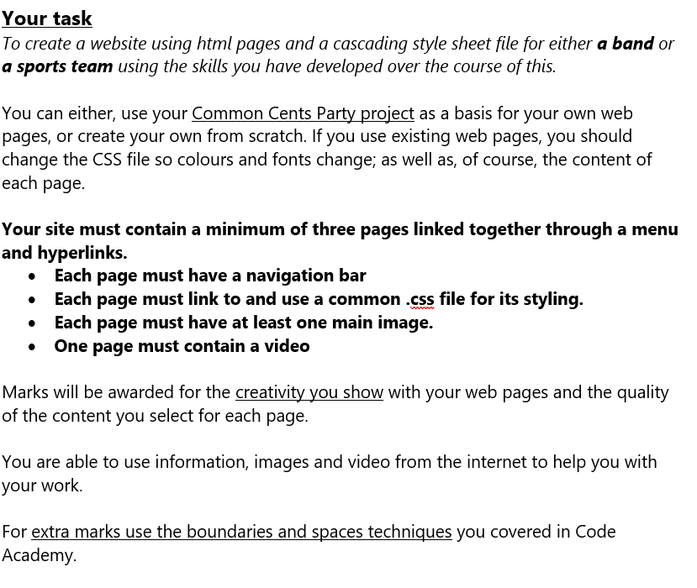
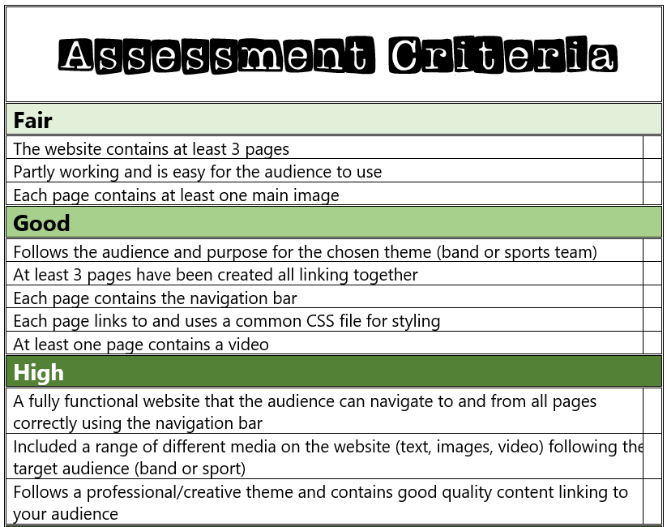
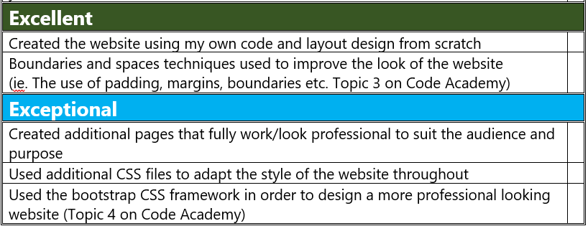

Slide 2
My Website Design Plan

Slide 3
Website moodboard – what is your website about?
On my power point I would like to create and add all the information so that anyone wondering about the sport would be able to get all the information, facts, and details by staying on my website.
I would like to make my website easy to access and accessible for anyone and everyone.
My website is about Acrobatic Gymnastics – Acrobatic Gymnastics ( also known as acro ) is a team-based discipline blending dance, gymnastics and acrobatics, performed in pairs or groups on a spring floor set to music, emphasizing trust, strength, flexibility, and coordination through balances throws and tumbling elements.

Slide 4
Page 1 contents
An explanation on what this sport is.
Nav bar to link to other pages.

Slide 5
Page 2 contents
Photos on what it looks like in action.
Nav bar to link to other pages.

Slide 6
Page 3 contents

Slide 7
Extra features…

