Slide 1
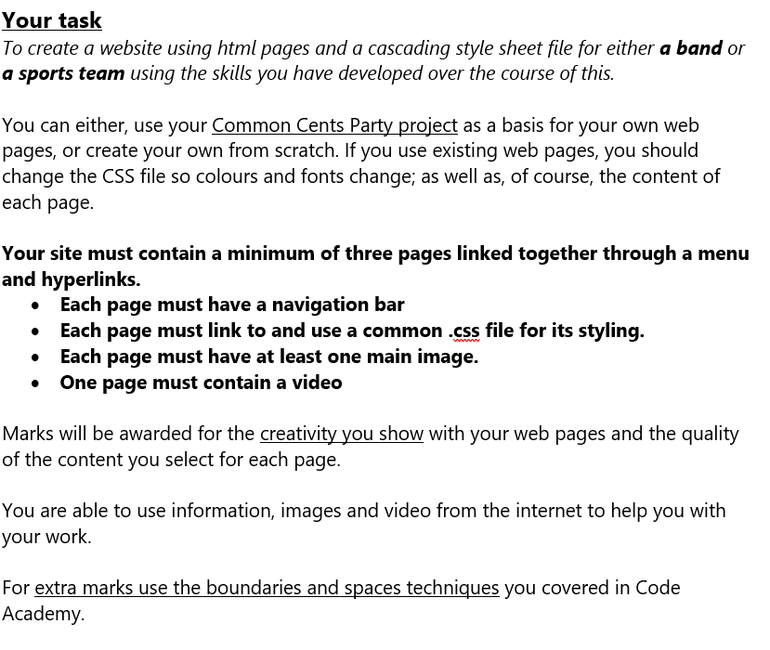
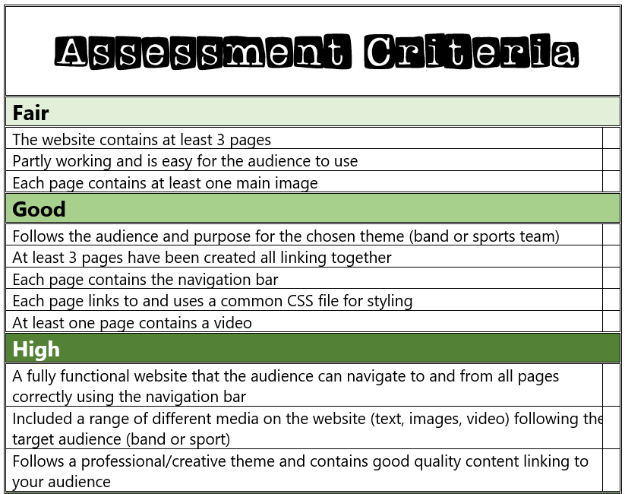
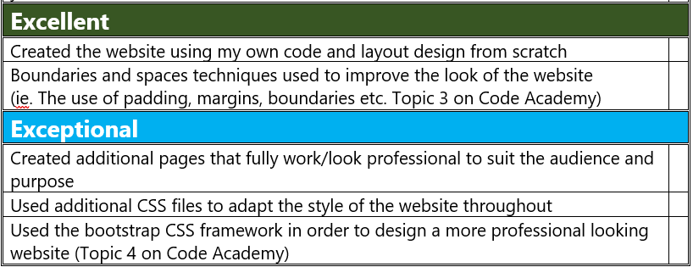

Slide 2
My Website Design Plan
By Josephine Song

Slide 3
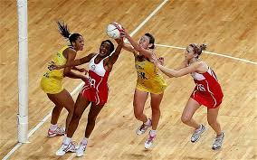
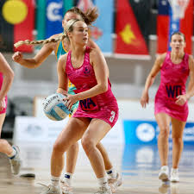

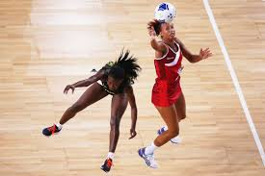
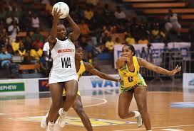
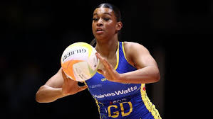
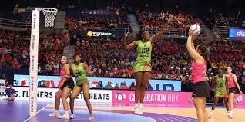
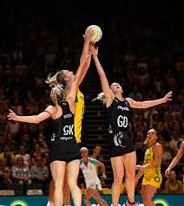
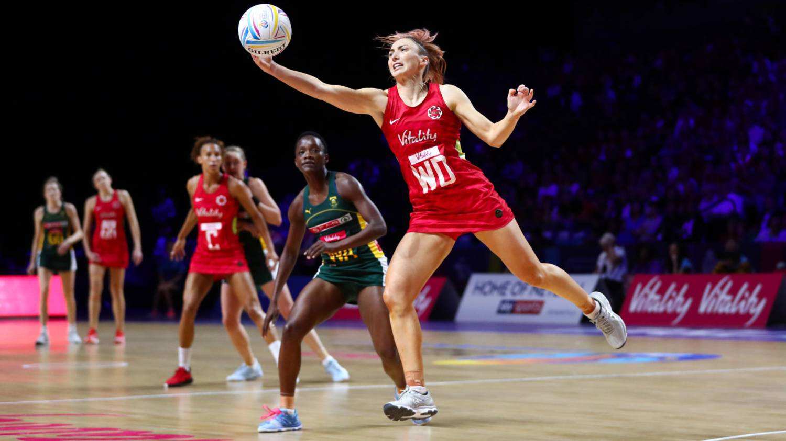
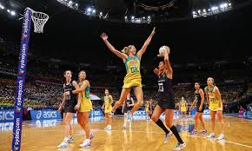


Website moodboard - what is your website about?
My website shows how to play netball and the key 5 rules
My website also shows famous players
My website also shows all the positions in netball

Slide 4
PAGE 1 - how to play netball & 5 key rules
This page will contain:
2 images
Short paragraph on how to play netball
List of key 5 rules
Different font sizes

Slide 5
PAGE 2 - positions in netball
This page will contain:
• Few images
• A short video showing the positions on court
• List showing what are the positions

Slide 6
PAGE 3 - famous players
This page will contain:
• Images of the most famous players
• Details about each of the players ( e.g. position, height, who they play for etc )

Slide 7
Extra features…

