Slide 1
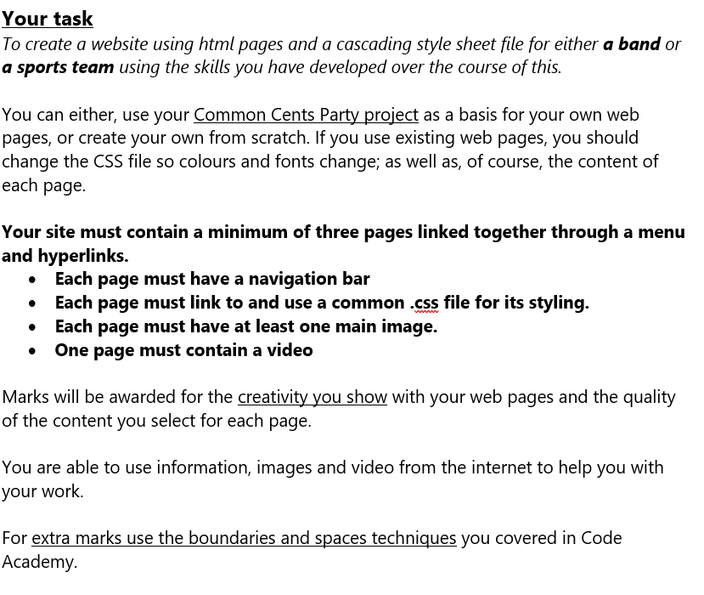
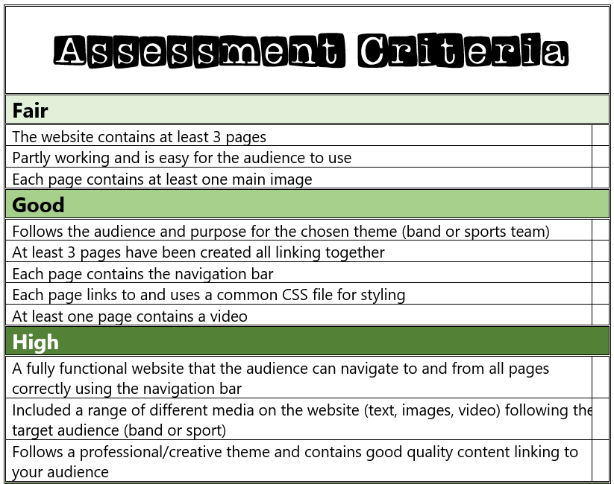
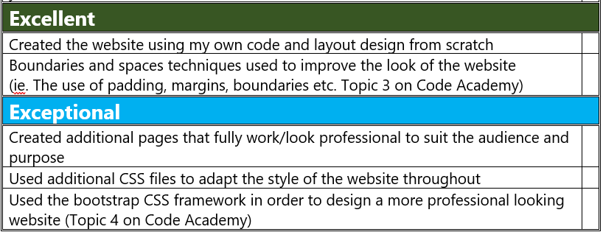

Slide 2
My Website Design Plan

Slide 3
Website moodboard – what is your website about?
Different Disciplines
Equestrian Sports
Popular place to ride at
Popular shows
to watch
My Website
What is it?
Different types of equipment and what they’re used for

Slide 4
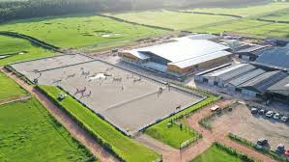
Page 1 contents
- Image
- Description on what is horse riding
- a link to a page about show jumping
- a link to a page about dressage
- a link to a page about eventing
- a nav bar
- A link to a page about hacking

Slide 5
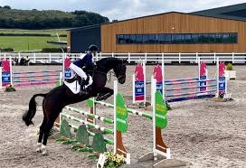
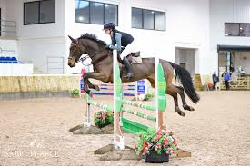
Page 2 contents
-A page all about show jumping
- 2 images
- a video?
- description about it
- a title

Slide 6
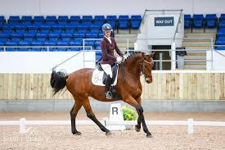
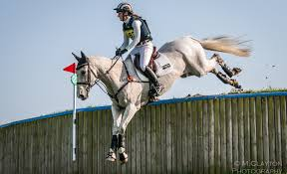
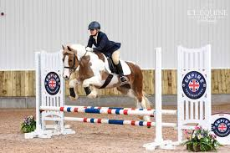
Page 3 contents
- a page about eventing
- a video?
- 2 images
- a title
- a description

Slide 7
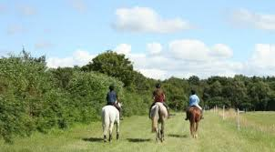
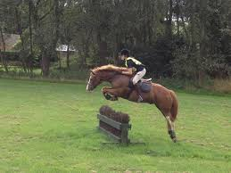
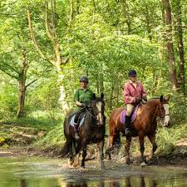
Page 4 contents
- a page about hacking
- a video?
- 2 images
- a title
- a description

Slide 8
Extra features…

