Slide 1
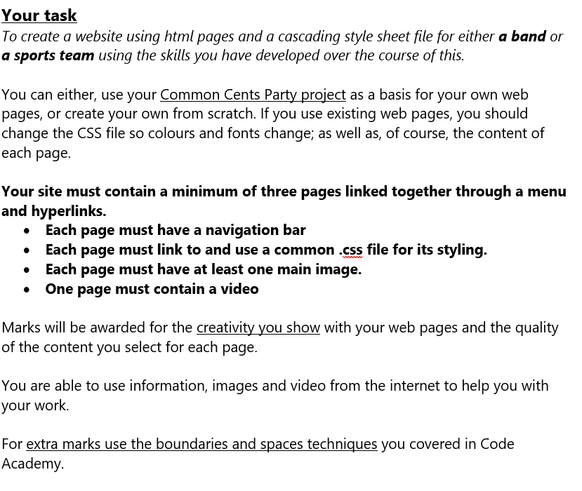
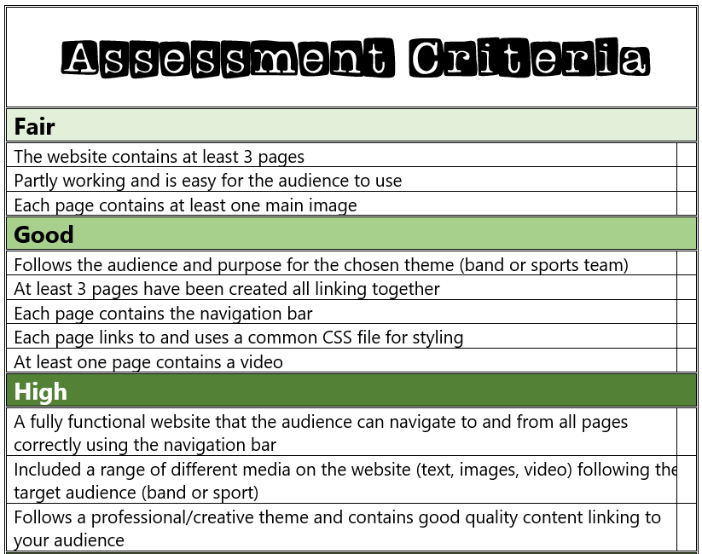
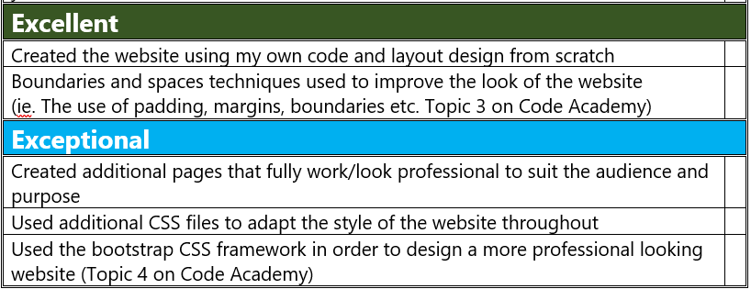

Slide 2

My Website
Design Plan
OLIVIA TICKELL

Slide 3
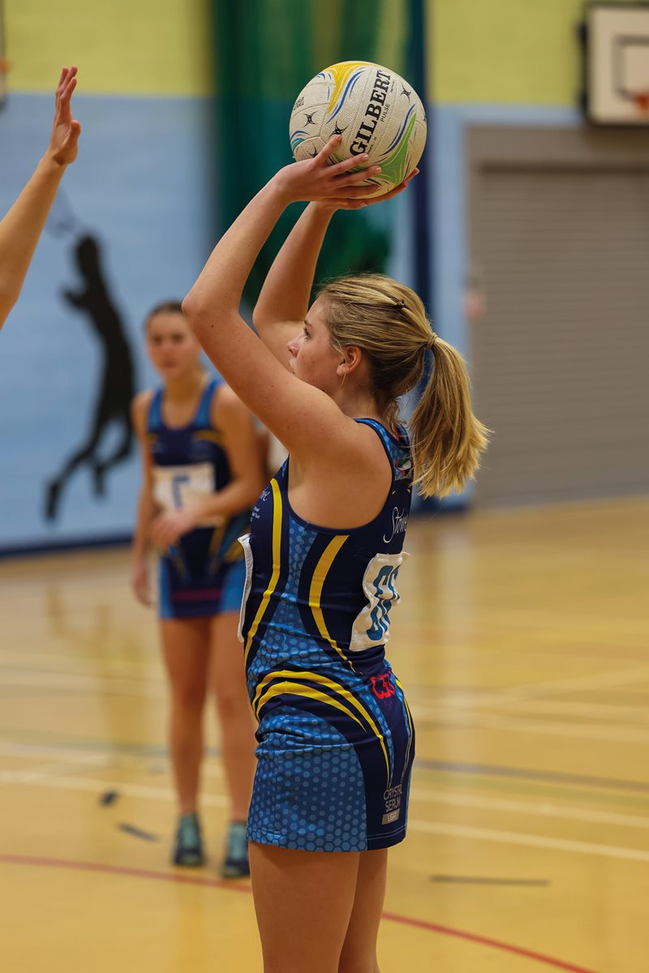

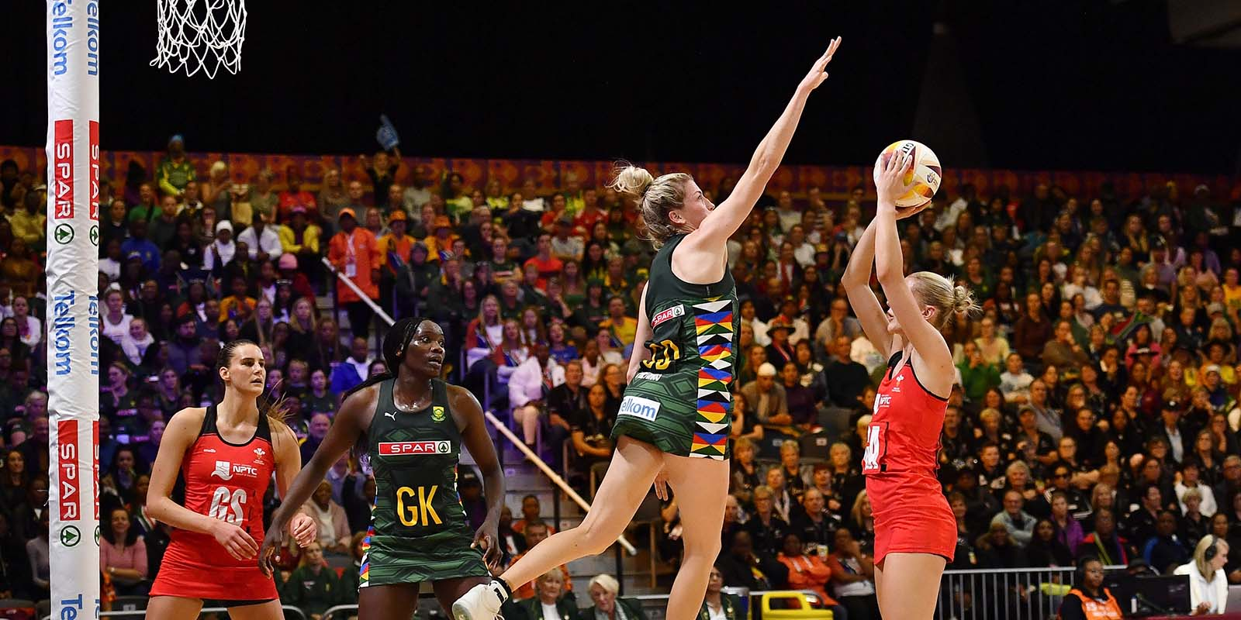
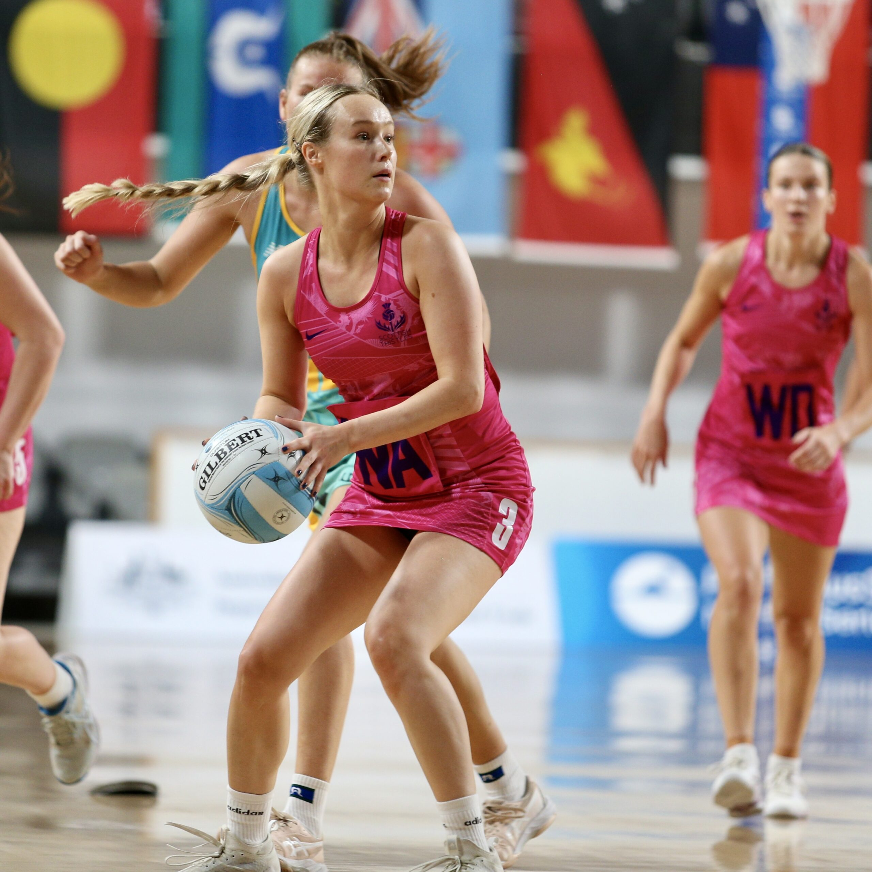
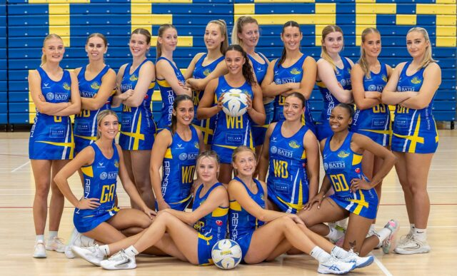
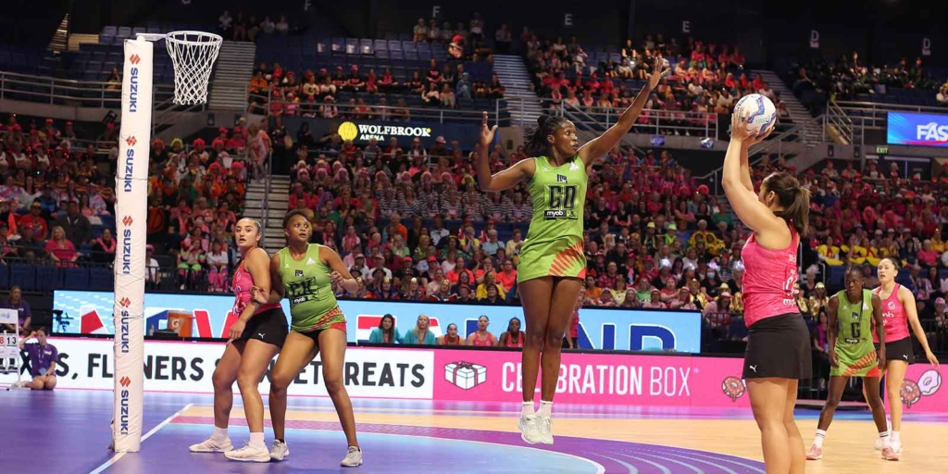
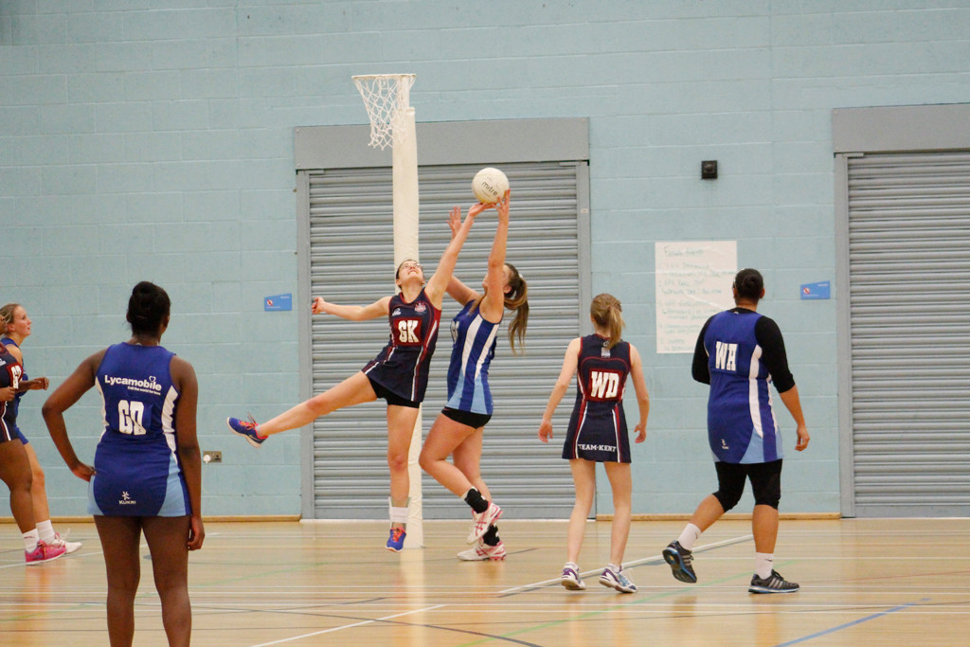
Website mood board what is your website about?
-About netball
-Where you can play -What it is
-Leagues
-Positions

Slide 4
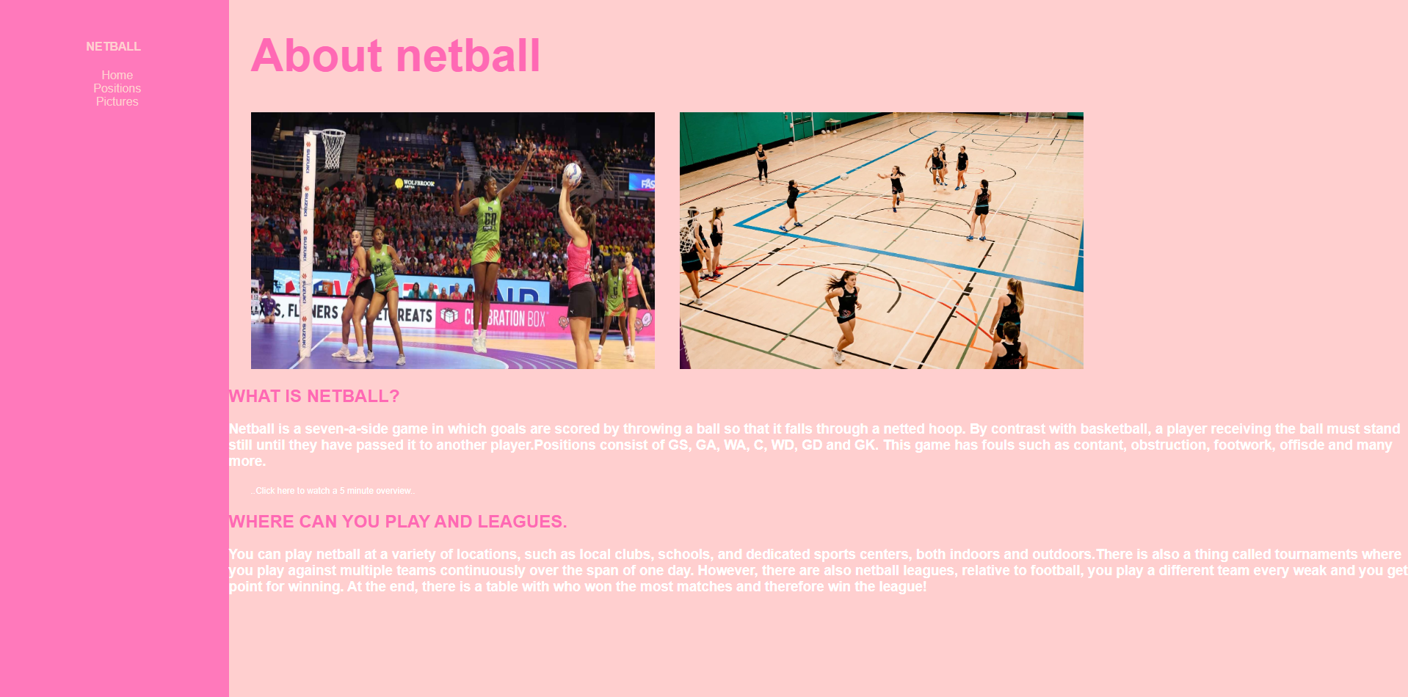
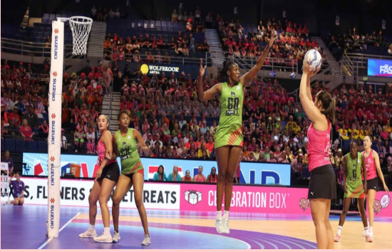
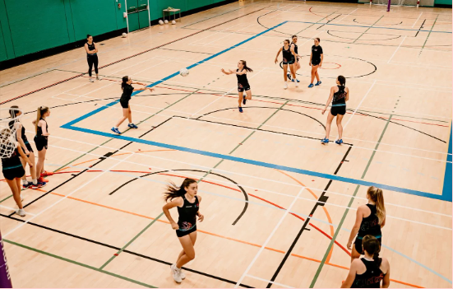
Page 1 contents
The first page holds all the information about what the sport is and how to play it.
This page includes two images and a “click to watch a video” text which links to a video. I embedded this video by using the <a href> property.
This page has different colours, fonts and font sizes. It also has a margin down the side with a navigation bar which will take you to different pages.
IMAGES USED
<<< >>>

Slide 5
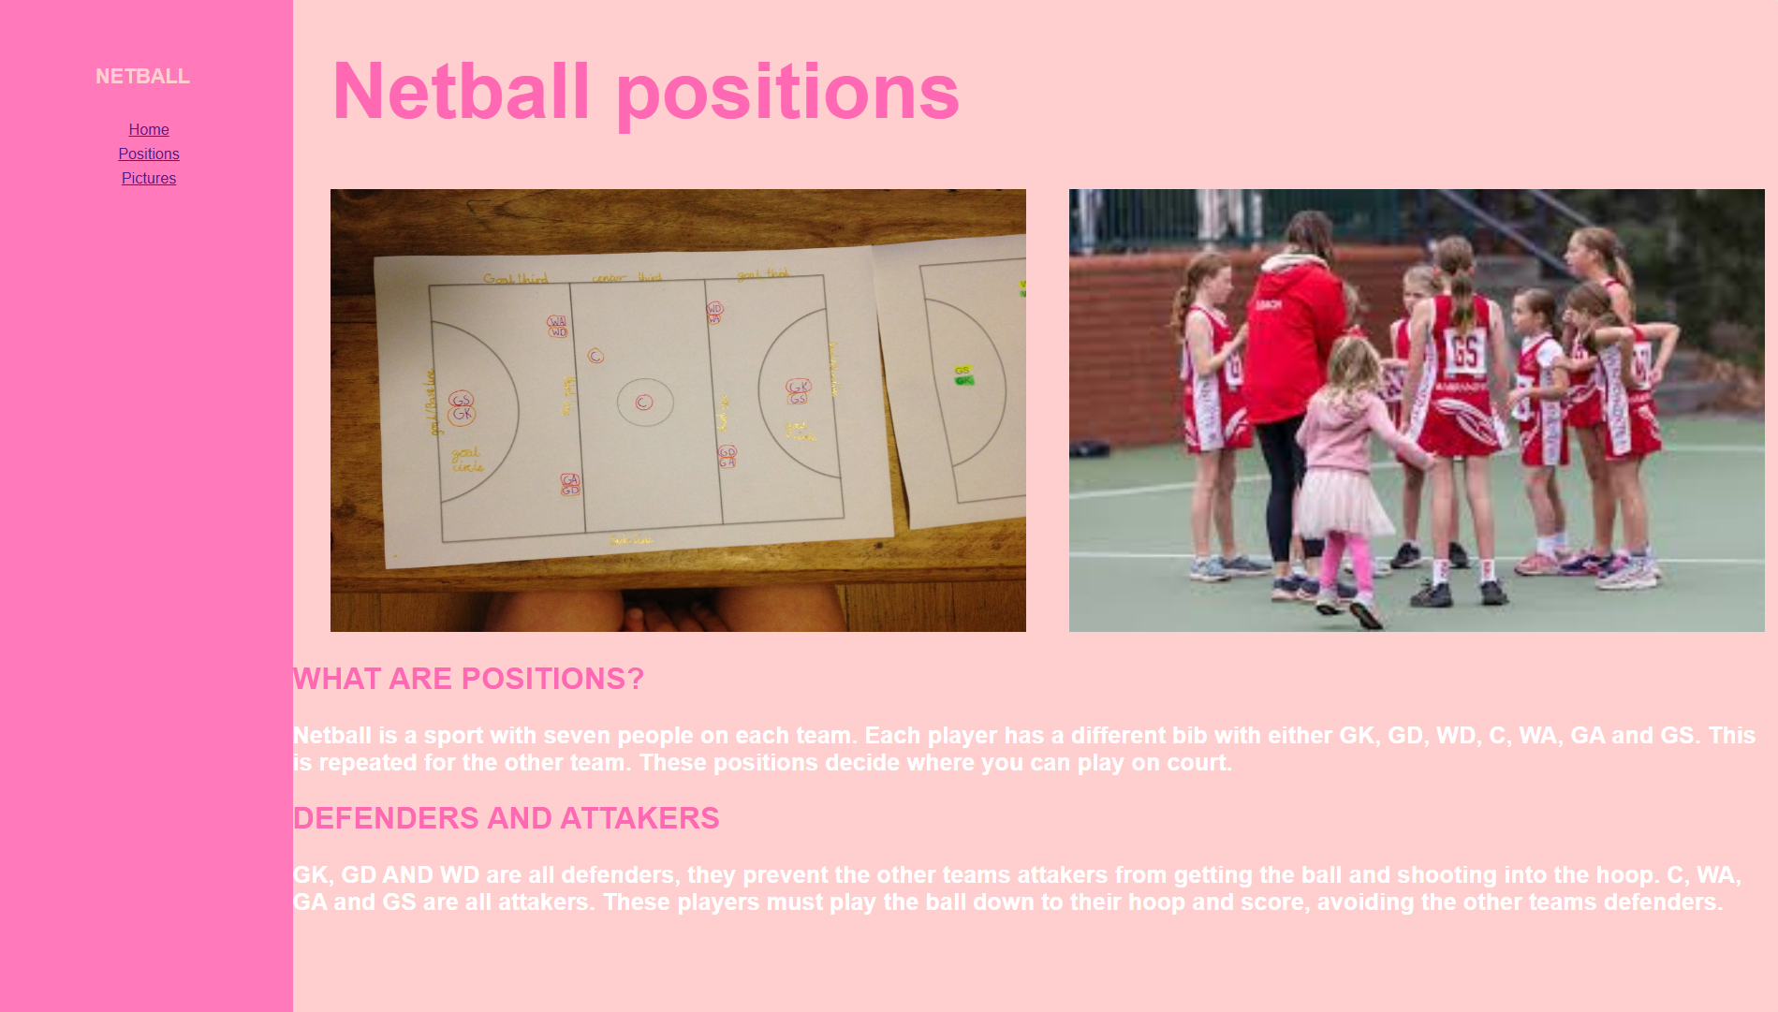
Page 2 contents
The second page contains information about positions and what they mean.
This page includes two images and information.
This page has different colours, fonts and font sizes and has a margin down the side including a navigation bar.

Slide 6
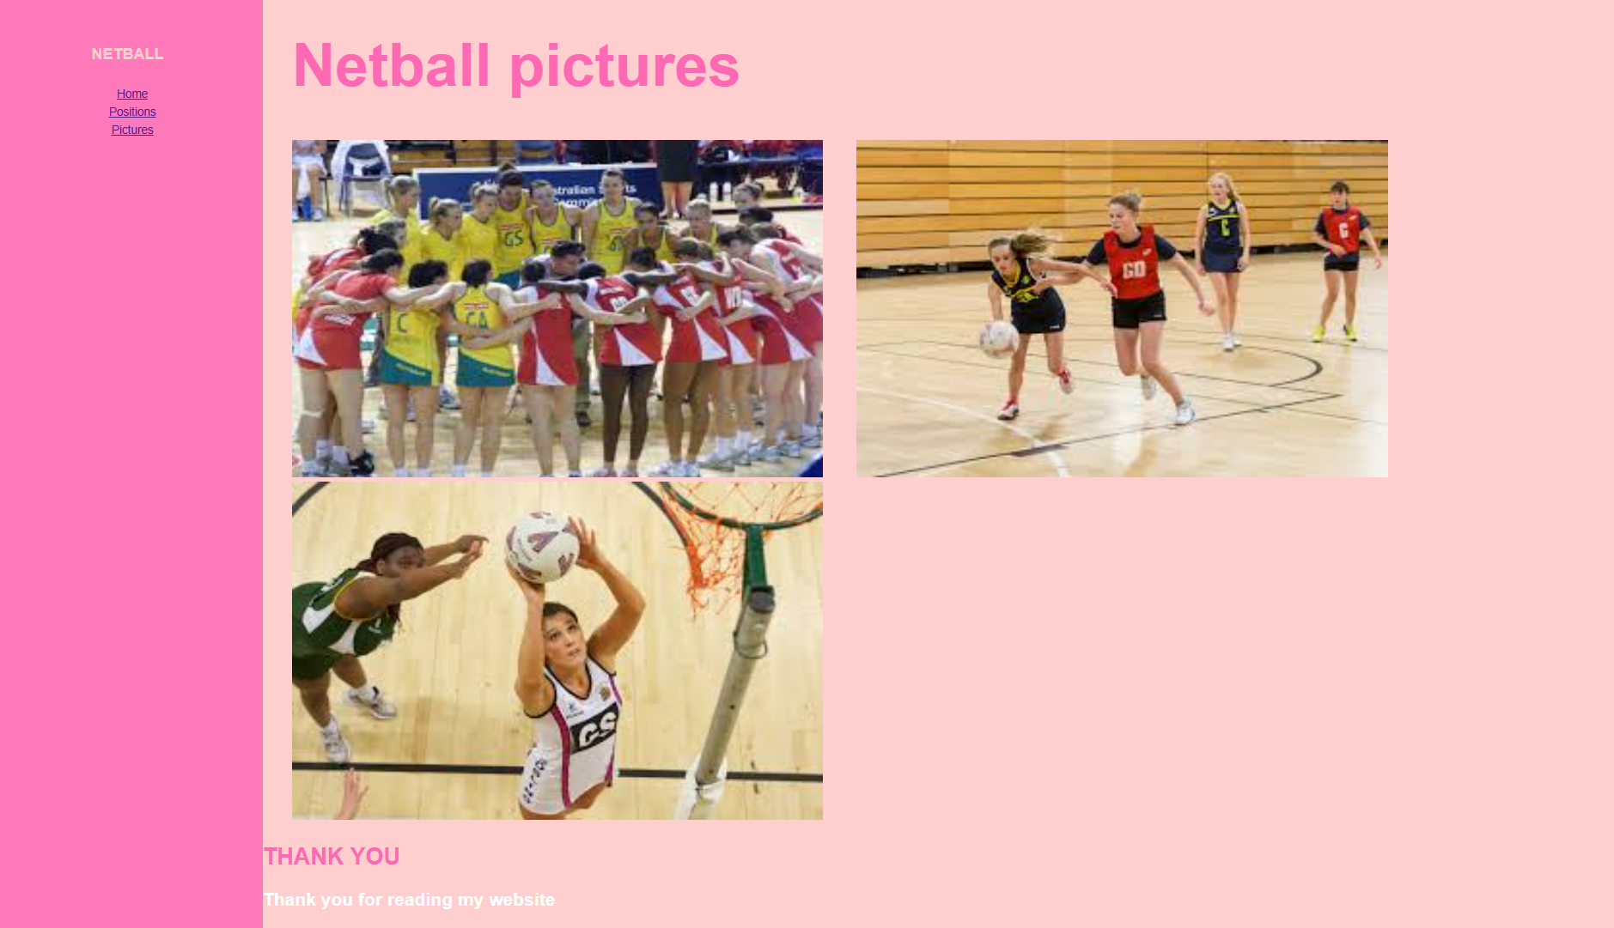
Page 3 contents
The third page contains pictures of netball including some text.
This page includes three images and a small thank you at the end. I inserted these images with the <img src> property.
This page is very colourful, including different colours, fonts and font sizes and has a margin down the side including a navigation bar.

Slide 7
Extra features…
CHECKLIST:
-Two or more images per slide
-One video
-3 pages
-Navigation bar
-Fonts, sizes and colours
-Margin
-Information

