Slide 1
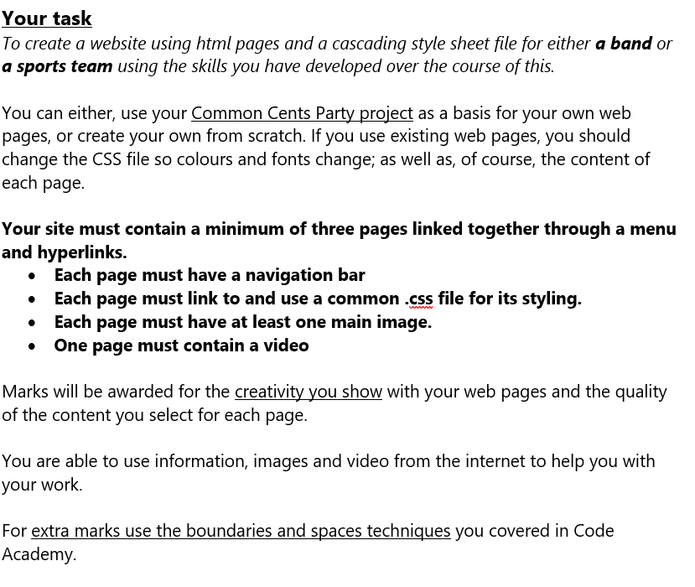
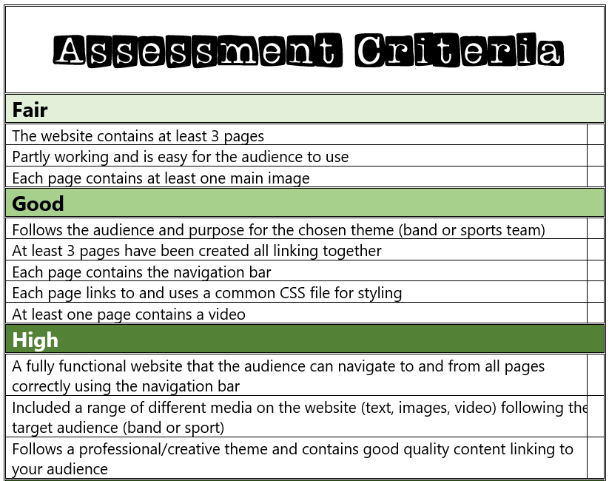
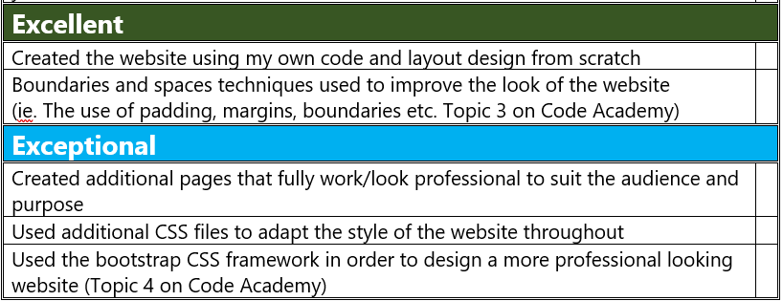

Slide 2
My Website Design Plan

Slide 3
Website moodboard – what is your website about?
My Website is about acrobatic gymnastics
I would like my website to include:
All the information that you will need to understand the sport!
Lots of photos and videos as examples of the sport.
Different competitions and event information.

Slide 4
Page 1 contents
Title
Photos/Videos
Introduction to the subject
Nav Bar with links to next web page

Slide 5
Page 2 contents

Slide 6
Page 3 contents

Slide 7
Extra features…

