Slide 1
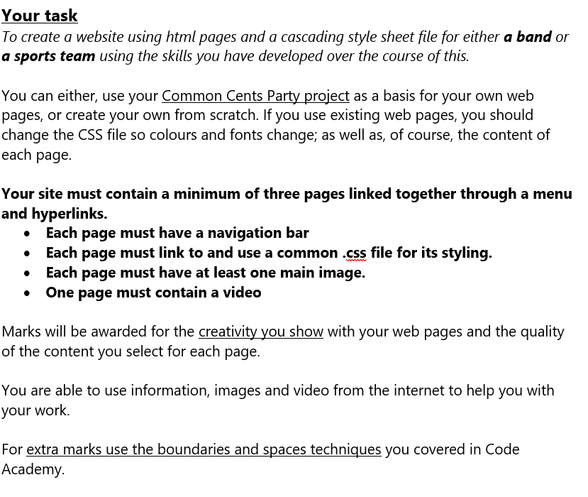
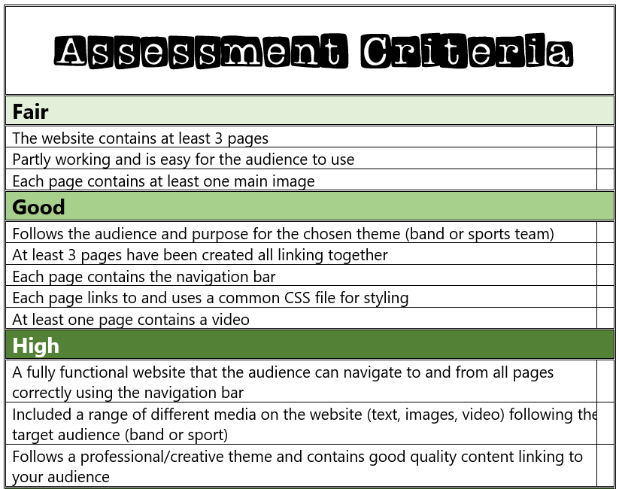
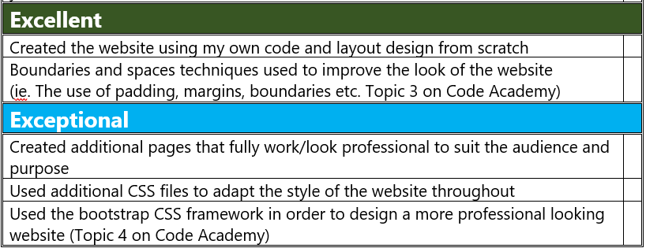

Slide 2
My Website Design Plan

Slide 3
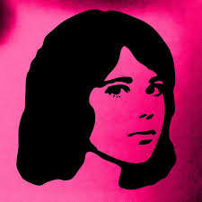
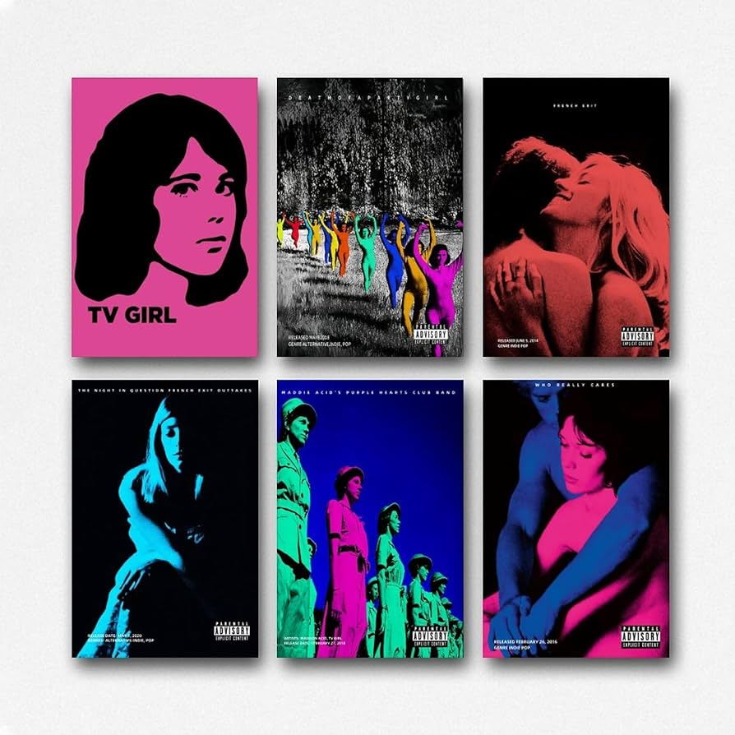

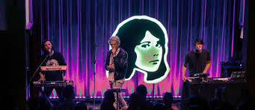

Website moodboard – what is your website about?

Slide 4

Page 1 contents
Main page what the band is
Tv girl is an American indie/hypnotic pop band. The band was formed in 2010, and their first full album(Lonely Woman) came in 2014. the band gained popularity in 2022. their Spotify following is now 12,932,854 followers. Their songs are unique as they use old samples of voices in their songs. Some of their most famous songs do this like: Not Allowed, Taking whats not yours and Lovers Rock.
https://www.youtube.com/watch?v=c8eL7KJva7E

Slide 5

Page 2 contents
They have 9 albums in total
The most famous one is Who Really Cares

Slide 6
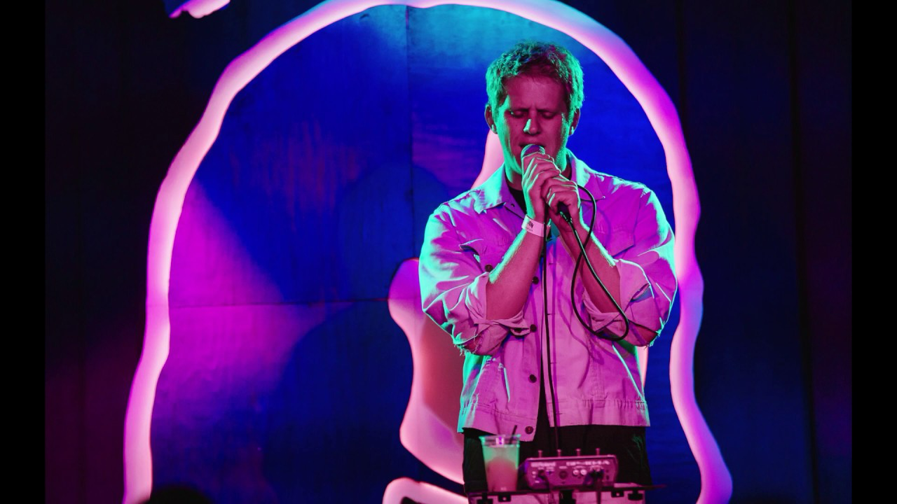
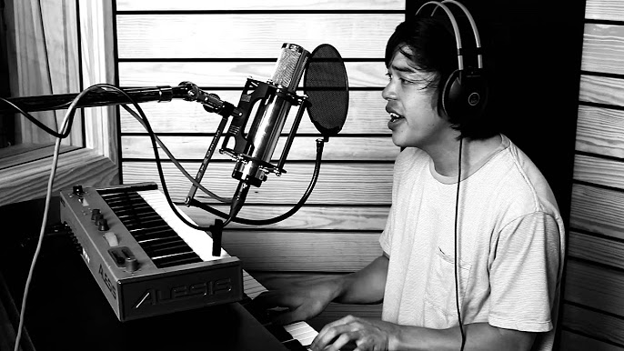
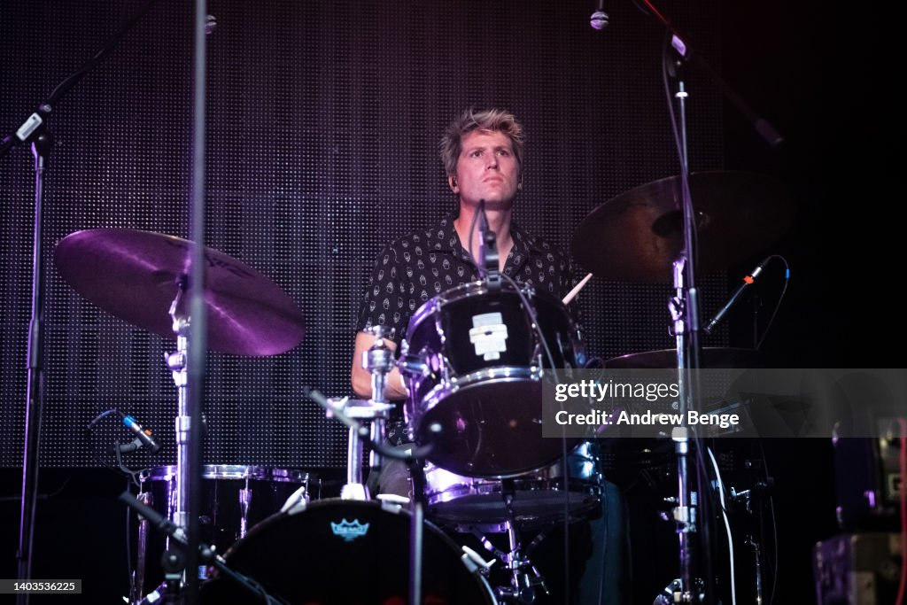
Page 3 contents
The group was founded by Brad Petering who is the lead singer, songwriter, and creative driving force behind TV Girl’s signature lo-fi sound, blending dreamy melodies with ironic, introspective lyrics. Jason Wyman was an early member and producer who helped shape the band’s sampling-heavy style before departing, while Trung Ngo contributed as a bassist and collaborator during the band’s formative years. Over time, TV Girl has functioned more as a flexible project than a fixed lineup, with Petering remaining the constant presence as the band evolved in sound and popularity.

Slide 7
Extra features…

