Slide 1
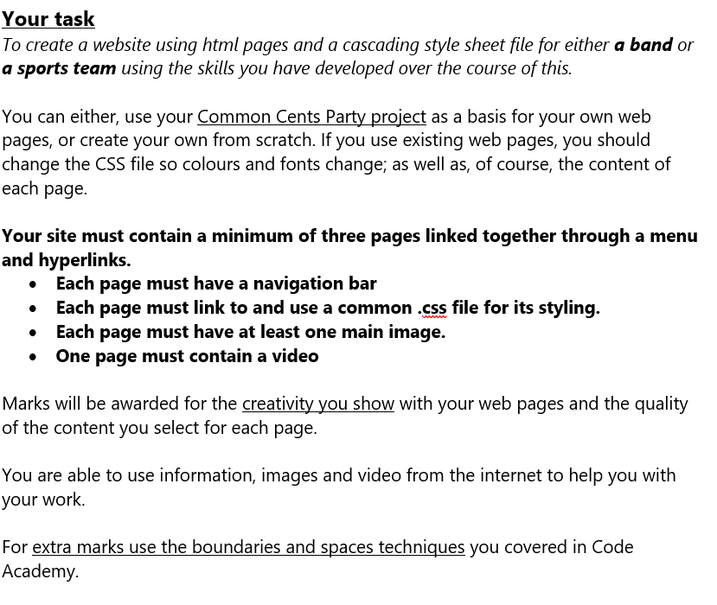
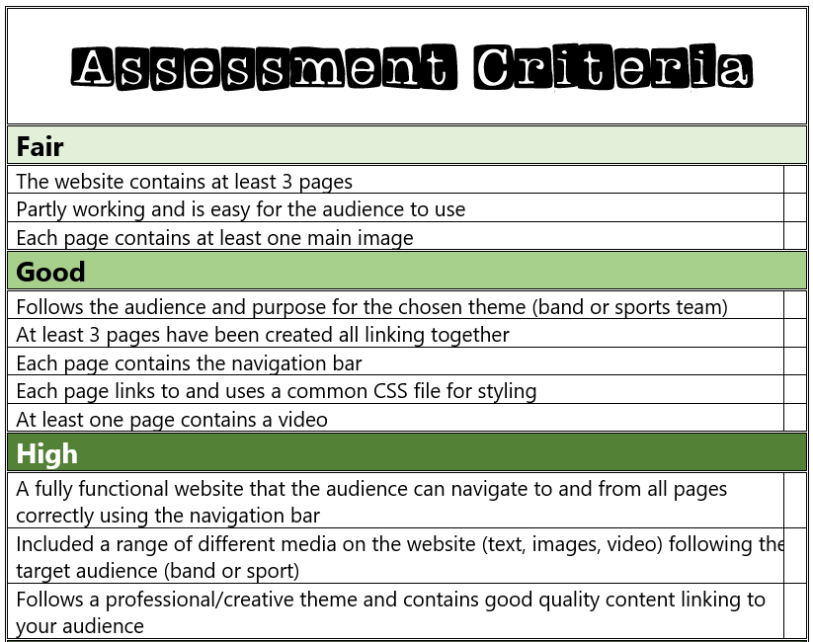


Slide 2
My Website Design Plan

Slide 3
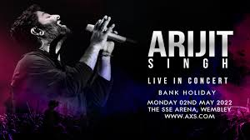
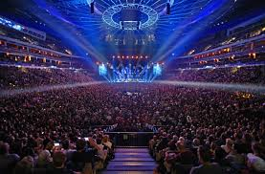

Website mood board – what is your website about?
My website is about bands and I have gone with Arijit Singh! My colour themes I am going to do for this website is vibrant because the theme is very vibrant and also quit pale colours every time the performs. His songs can be quite emotionally happy or quite sad which is why I have gone for a very pale/quiet like palette of colours.

Slide 4
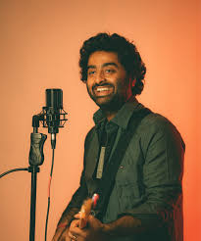

Page 1 contents
1st page is about who he is, what his concerts are like, and reviews too! My first page also contains Where to book along with a link of the booking and sample videos of the concert too… My plan is also to put a lot of detail about each of my categories on page 1- and including plenty of photos too.

Slide 5
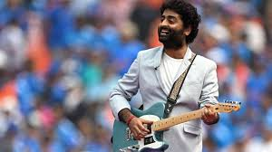
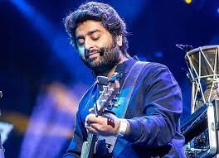
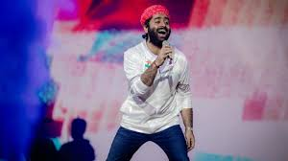
Page 2 contents
My next page will be all about the available timings and also the different locations he will be travelling to. Arijit Singh's 2025 concert!!
Page 2: Who is Arijit Singh and what are his concerts like: (plus reviews too)Arijit Singh is an incredible Indian playback singer, composer, and music producer known for his work in Bollywood films and his global success. He gained widespread fame with the song “Gehra Hua" from the 2025 film Dhurandhar or the emotional title song from Ae Dil Hai Mushkil from Ae Dil Hai Mushkil and his music has gained massive popularity, with tens of millions of monthly listeners on platforms like Spotify.
He is ahead of US pop megastars Olivia Rodrigo, Doechii and Gracie Abrams in the list of most-listened-to artists on Spotify around the world each month – and just one place behind Harry Styles – is a man that most British listeners have probably never heard of: the Bengali artist Arijit Singh. He has never had a song in the UK Top 100 singles or albums charts, yet thanks to a passionate fan base in the Indian diaspora, he is to become the first Indian musician to play a UK stadium concert… A singer and multi-instrumentalist capable of hopping from a synth-laden dance banger to traditional Indian classical music, Singh has astounding technical ability, and his searching vocal lines have an emotional impact to stop you in your tracks.
Arthanayake beseeched anyone unfamiliar with Singh: “Just see this as beautiful music, the language of which you may not understand, but the sentiment and vocal depth, you will feel. His range, his talent and his virtuosity makes him a once-in-a-generation artist, even for India.”

Slide 6
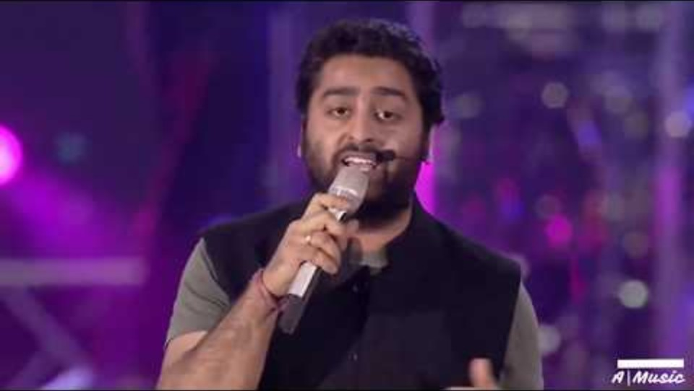
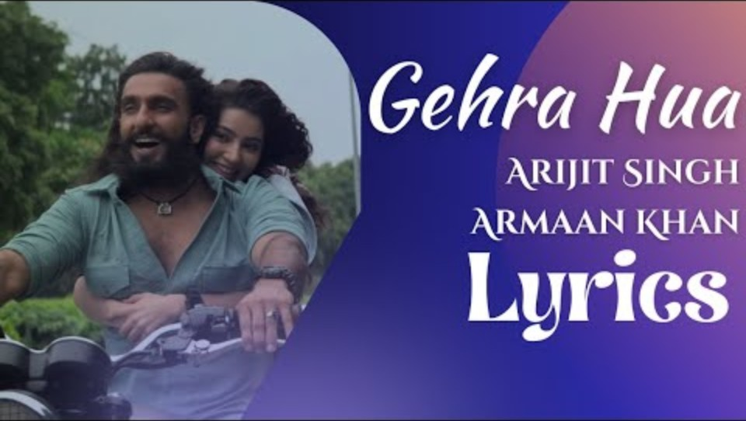

Videos that were on page 2 and samples too
Song: Ae Dil Hai Mushkil Song: Gehra Hua Song: Satranga- one of the No.1 hits on Spotify for his songs too

Slide 7
Page 3 contents
Information on how to book, where to go and much more :
To book Arijit Singh concert tickets, find upcoming dates on official ticketing sites like Ticketmaster, venue websites, or trusted resellers like SeatPick and StubHub, then select your event, choose seat/ticket type (checking VIP/Hospitality options for big venues), and proceed to checkout; for sold-out shows, use resale platforms, but always prioritize official sources first to ensure genuine tickets.
https://www.ticketmaster.co.uk/arijit-singh-tickets/artist/2006598?page=1 You can book via @Ticketmaster for his shows!
Where to go:
Have a look at the Official Ticketing Platforms: StubHub, Ticketmaster UK, SeatPick, Viagogo. Artist-Specific Sites: Look for official tour pages like arijitconcerts.com or venue sites (e.g., Tottenham Hotspur Stadium for past events).Concert Trackers: Songkick (shows upcoming Abu Dhabi dates). Recent & Upcoming Locations: UK: Recently played at The O2 Arena (London), Co-op Live (Manchester), and Utilita Arena (Birmingham) in 2024, with a major 2025 show at Tottenham Hotspur Stadium . International: Scheduled for Abu Dhabi (Etihad Arena) in December 2025.

Slide 8

Extra features…
Arijit Singh concert reviews are generally ecstatic about his powerful, emotive vocals and marathon performances (3-4 hours, 40+ songs), but often criticize the venue's sound quality/acoustics (especially stadiums like Tottenham Hotspur) and poor organization (crowd control, seating, staff rudeness), leading to mixed experiences, though fans praise his raw talent and energy.
Common Criticisms & Issues reviews
Sound Mixing: Several recent reviews mention poor audio, where loud drums or bass overpower his vocals, making lyrics unclear, though sometimes this gets fixed.
Theatricals: Some find forced theatrics or added EDM elements distract from his core musical talent, which shines best stripped back.
Venue Management: A few scattered complaints mention disorganization or poor staff handling issues at specific venues.
Positive Feedback/ reviews about his concerts
Mesmerizing Voice: Fans consistently praise his soulful voice, high notes, and emotional delivery, calling it a "heavenly massage".
Humble & Engaging: He's seen as genuine, interacting with the audience, blowing kisses, and making it feel personal, unlike other big stars.
Vocal Prowess & Endurance: He performs for hours, often without breaks, delivering medleys and showcasing incredible stamina and vocal control, with live arrangements often better than studio versions.
Variety: He seamlessly shifts from slow ballads like "Tum Hi Ho" to energetic dance numbers and even covers English songs (like Linkin Park, Owl City) or regional tracks.
A live performance sample of Arijit Singh singing live in Sydney, Australia

