Slide 1
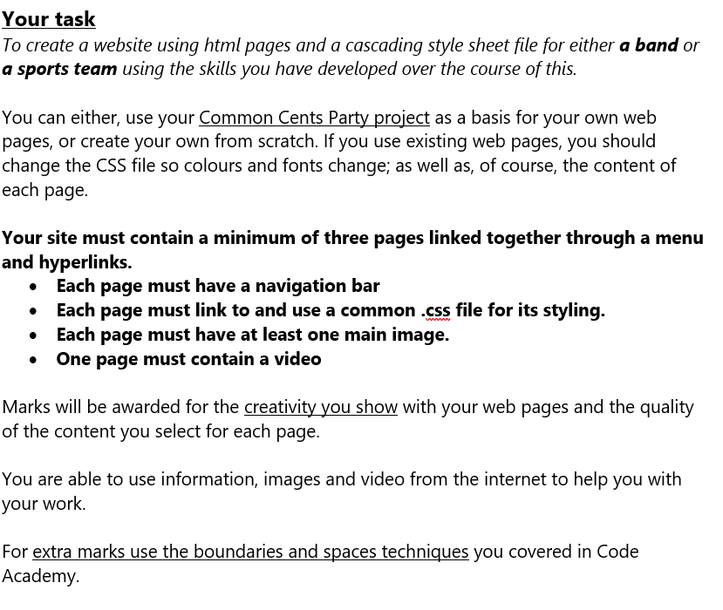
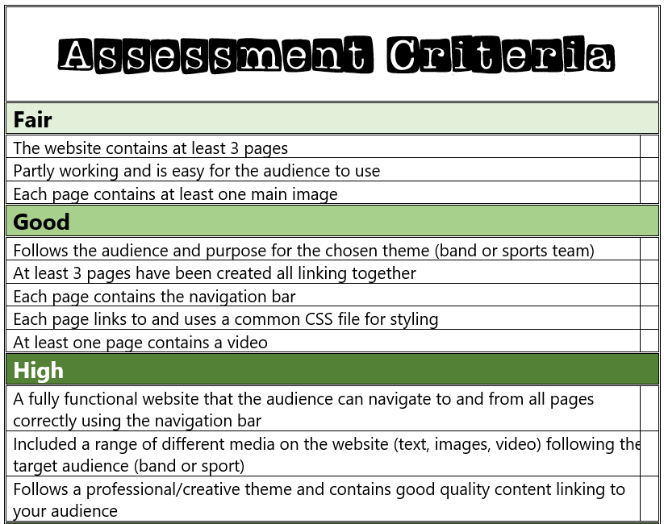
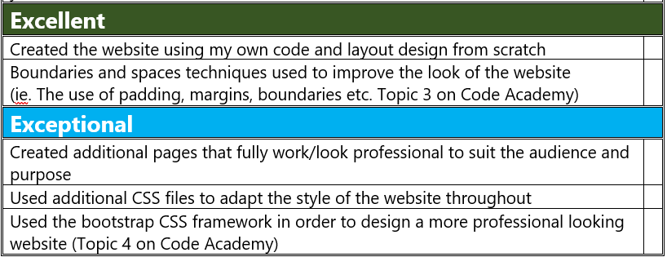

Slide 2
My Website Design Plan
BY ellie tomonaga

Slide 3
Website moodboard – what is your website about?
A UK based fake band called the Dimmer Brother’s, who specialise in country music. The band is a group of four childhood friends, who enjoy making music and having fun. Colourful website, each page in a different, vibrant colour (Colours to be decided later). Non-stick nav bar, using tables to space things out.

Slide 4
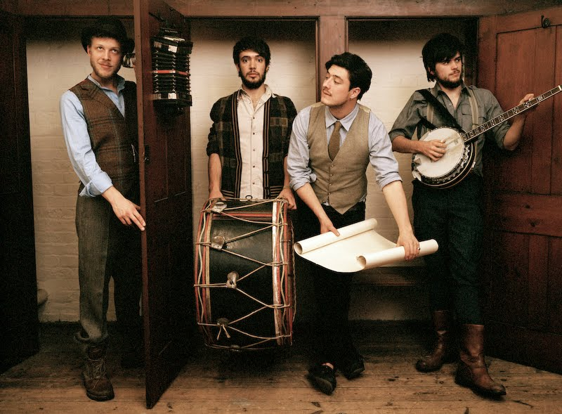
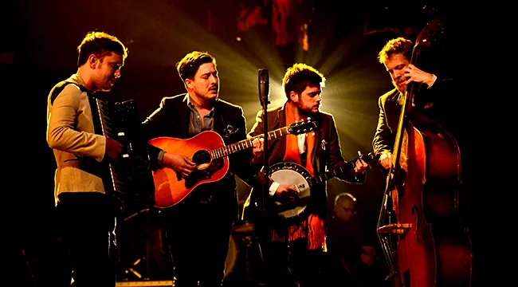
Page 1 contents
Home page, giving a brief overview on who the band is, with a picture as well as a small quote from a magazine about them. Include pictures (like an image gallery) and talk about potential upcoming albums. Hopefully a video .mp3 if can locate one, though its difficult. WIP
‘The Dimmer Brother’s, an up-and-coming band from Yorkshire, England, are a must see this year. Having released their most recent album ‘Light’s and Town Roads’ just last year, their popularity is steadily increasing, along with the promise of a new album on the way. While they previously focused on country-style songs, they have since progressed to indie pop, with high hopes for the next songs they produce. Their world tour ends in mid to late 2026, with further dates yet to come out after April, so it’s recommended to purchase tickets as soon as possible!’-Alternative Press

Slide 5
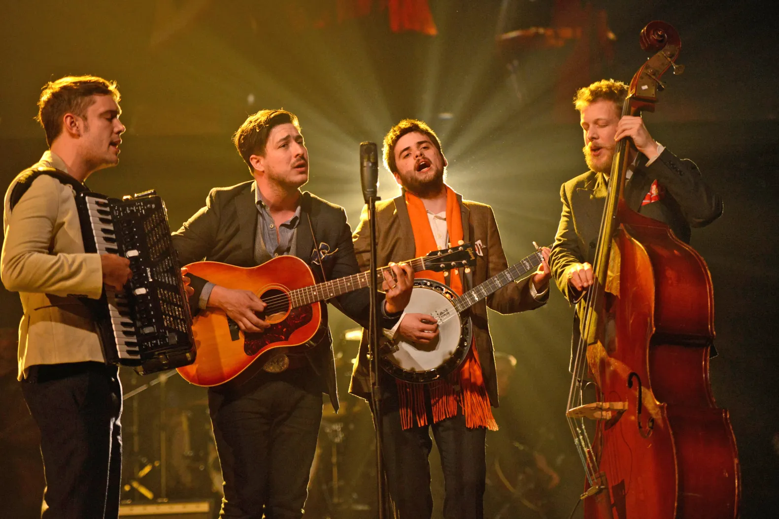
Page 2 contents
ABOUT US Page- Tells the viewer about the band and what they love to do. Talks about awards + origins. Add information about possible upcoming merch restock as well as upcoming tours and albums ect- make like news boards\ bulletin board. WIP
Welcome to the Dimmer Brother’s website! We are an indie pop band originally producing country-style music! Our first album, ‘Not Me’ was released in late 2017, with 6 albums being created since! Our dreams as a band began in childhood, when we all met at school, and began to write tunes that eventually formed the basis for our first album. Our dream has always been to inspire young people to create more interesting diverse music as a way to express themselves! We would like to also thank all our fans for their support and continued interest in our music and are proud to announce that we are in the midst of producing a new album between our world tour! We hope to see you soon!- The Dimmer Brother’s

Slide 6
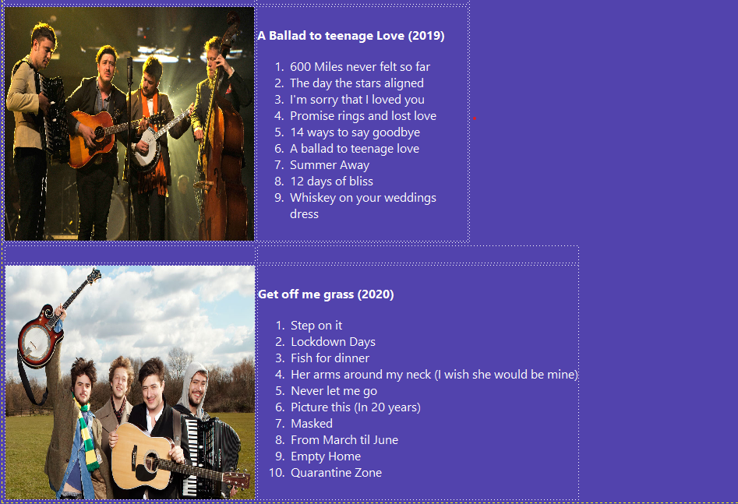
Page 3 contents
Songs page- displays released albums and EP’s. May also contain deluxe versions of albums and remastered versions. Lists all current songs in each album along with the year they were released, but also maybe an upcoming album.
Album 4 (2021)- Get off me grass (deluxe)
Step on it
Lockdown days (extended + edit)
Fish for dinner
Chips on the side
Her arms around my neck (I wish she would be mine)
Not now
Never let me go
Picture this (After 20 years)
Masked
From March til June
Interlude
Empty Home (it’s not fair)
So far but so close
Get off me grass
Quarantine Zone
Album 2(2018)-Another day
Don’t leave
Forever us
The day is young
Life isn’t fair
No matter how long it takes
Another day
Heartbreak
Album 5 (2024)-Lights and Town Roads
Country lanes
Broken Lamp Posts
Seagulls
London Smog
Starts in the sky
Rainbow (Let this last forever)
Is it time?
For now (It doesn’t matter)
Challenger
Saturday night TV
Album 1 (2017)- Not Me
Hello Again
Old friends, new beginnings
Who am I?
What I wanted from you
Heartbreak
Daydreaming on the beach
For now
Not me
Album 3 (2022)-Hello again
Diner stories
Pub chants
Chippy on the beach
An ode to childhood
Time to leave

Slide 7
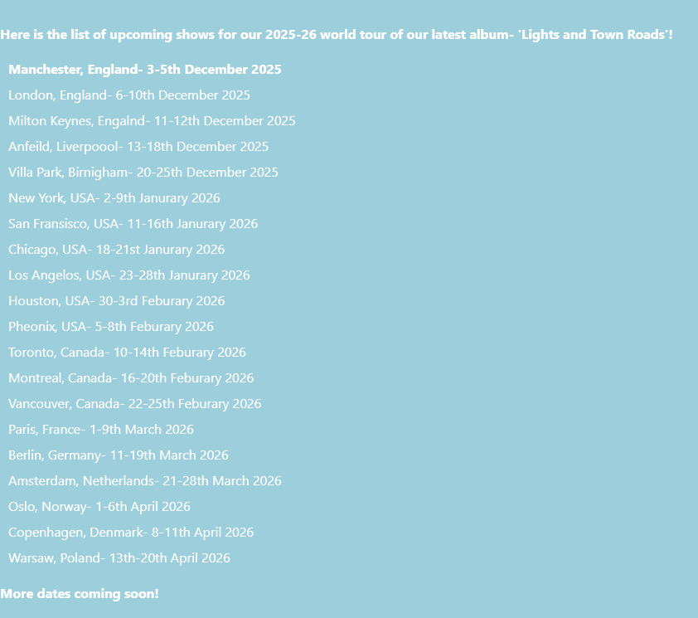
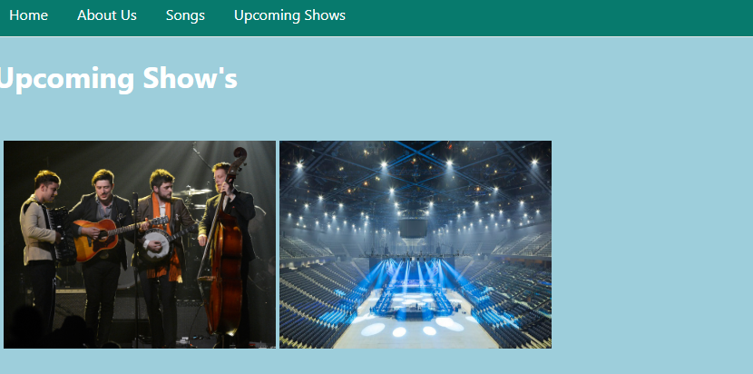
Extra features…
Page 4- Album tour; gives locations and days when they are performing during their world tour. Has a few pictures of the band and a stage in France where they’ve performed recently.

