Slide 1
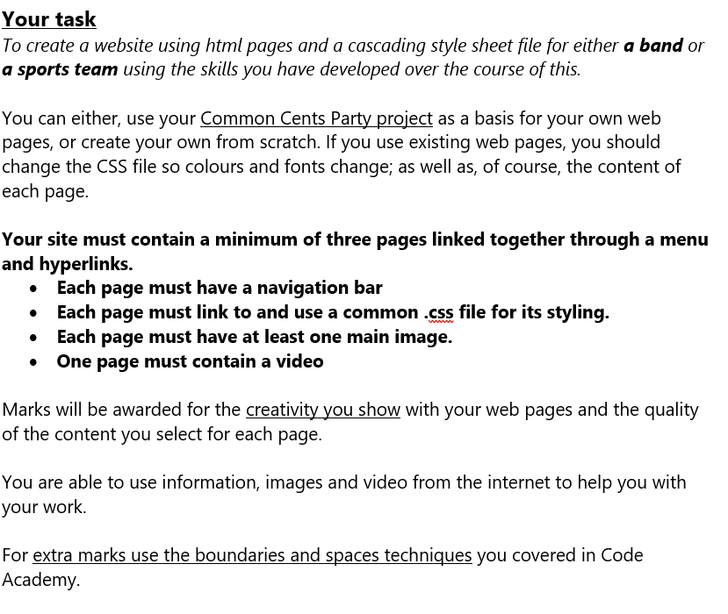
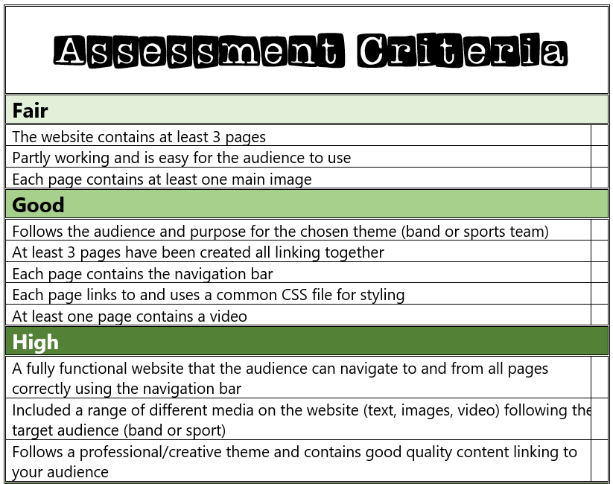
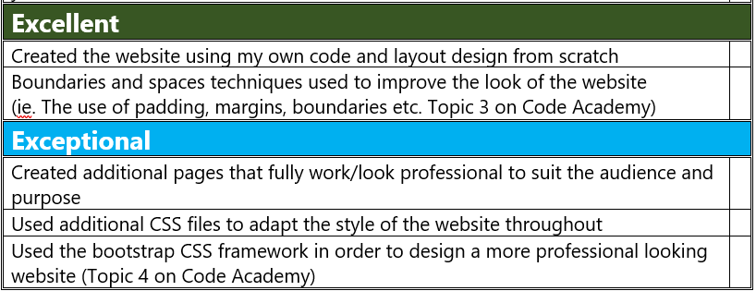

Slide 2
The Sydney Sixers

Slide 3
Website moodboard – what is your website about?
The Sidney sixers cricket team
They play in the big bash league
There up coming matches
The standings of the league

Slide 4

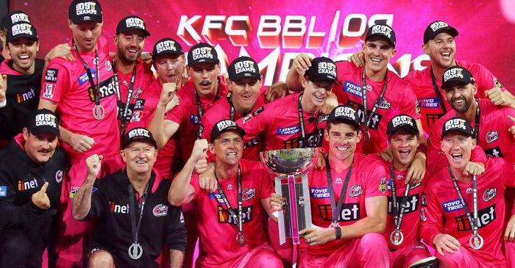
Home
The Sydney Sixers are a T20 team based in Sydney, Australia. I believe that they are the best team in the Big Bash League, which is the cup they play in of six teams. They have won it 3 times ( 2011-2012, 2019-2020 and 2020-2021).

Slide 5
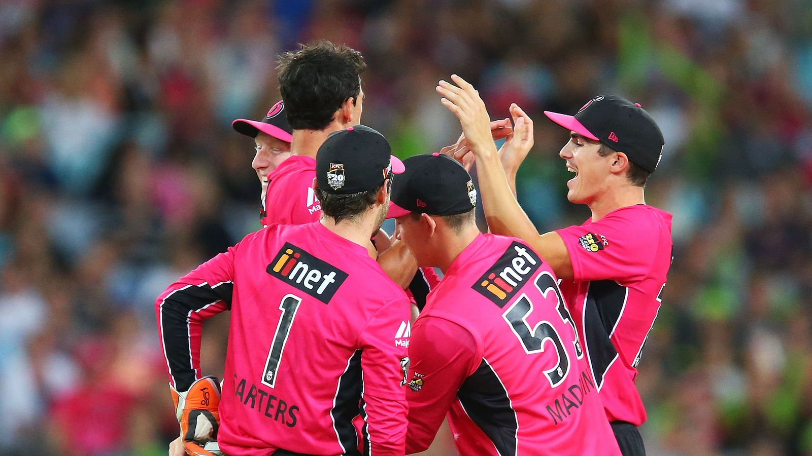

Matches
There up coming fixtures for the next month, the date of the match played, the team they are playing against and weather they won or not
https://www.cricket.com.au/videos/4189622/sydney-thunder-v-sydney-sixers-match-highlights-match-highlights-bbl14

Slide 6
Standings
The standings of the whole league including points, matches played, wins and losses
I have images saved cant get them on the power point

Slide 7
Extra features…
The colour scheme will be pink and black

