Slide 1




Slide 2
My Website Design Plan

Slide 3
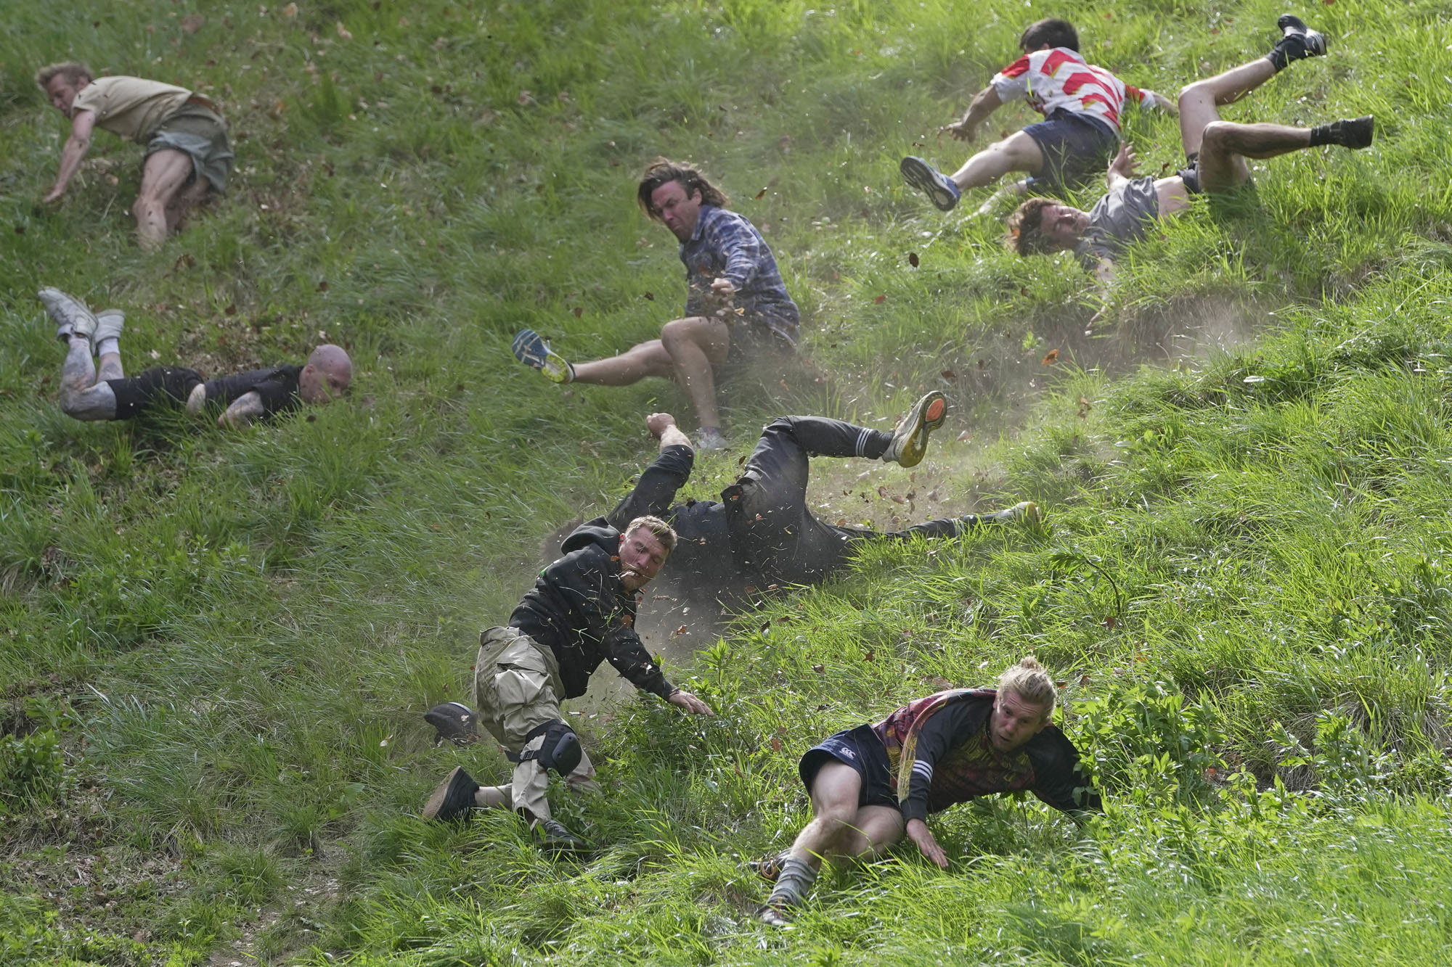
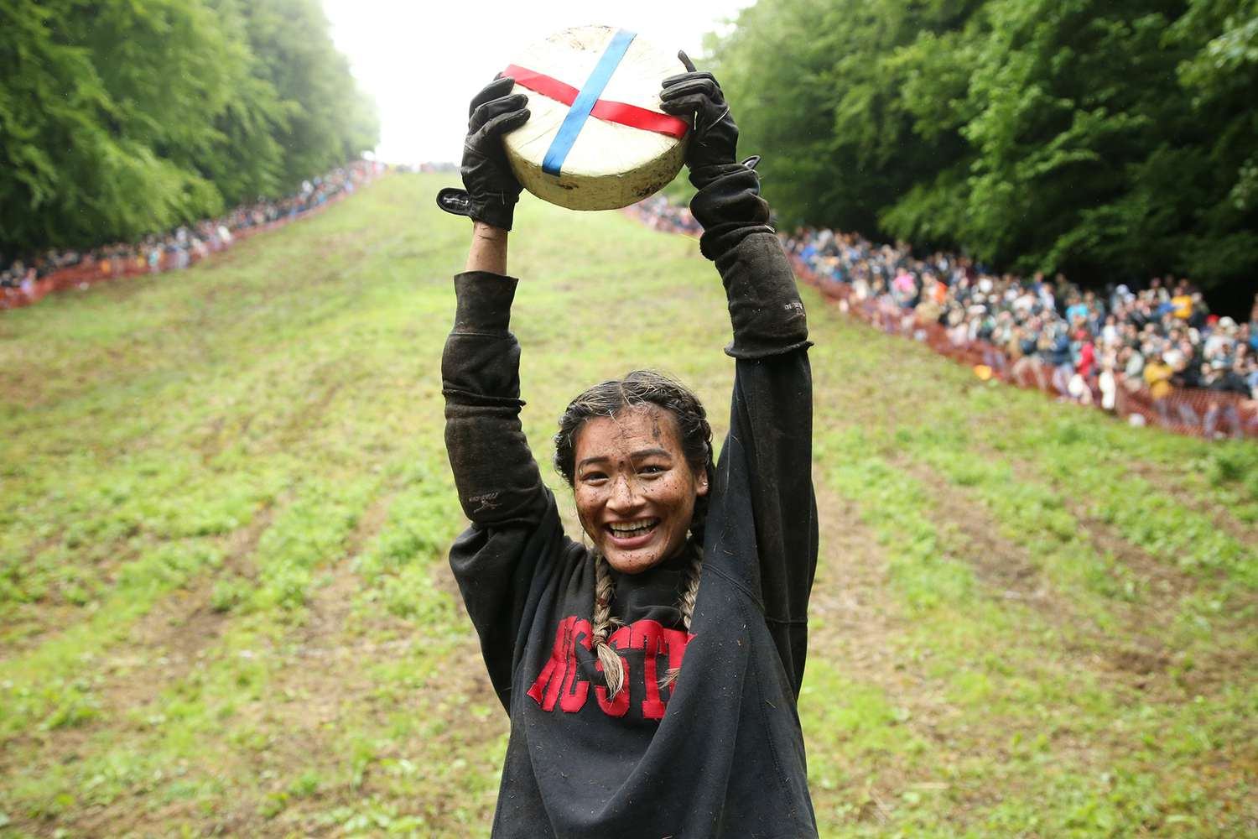
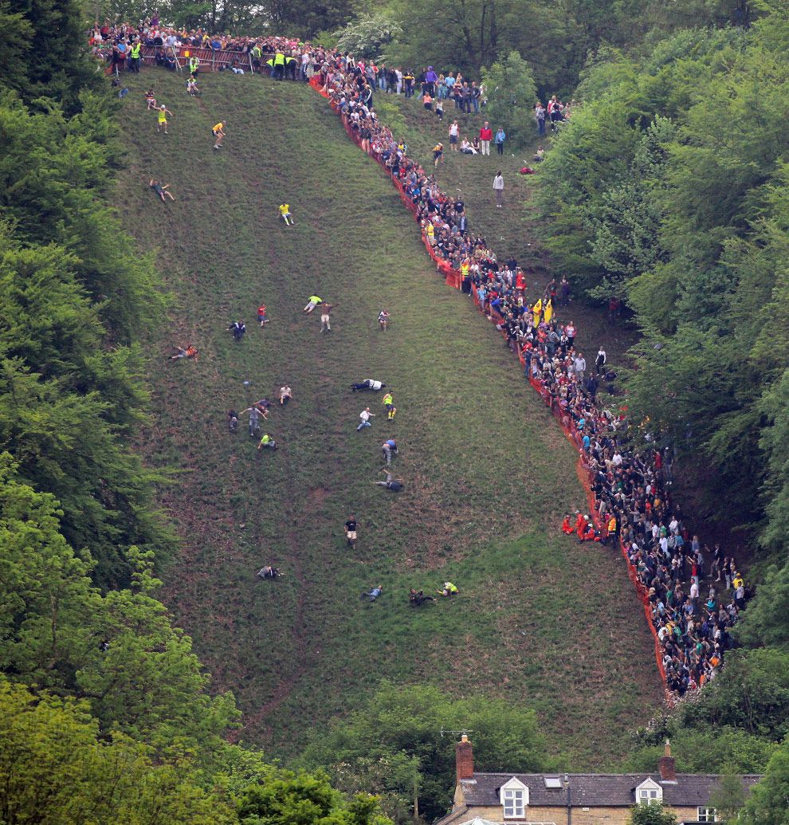
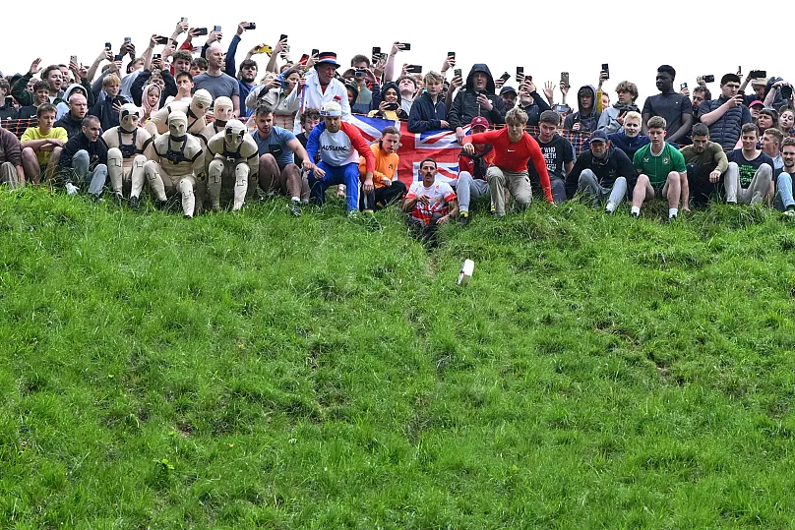

Website moodboard – what is your website about?
yellow
cheese down hill race

Slide 4
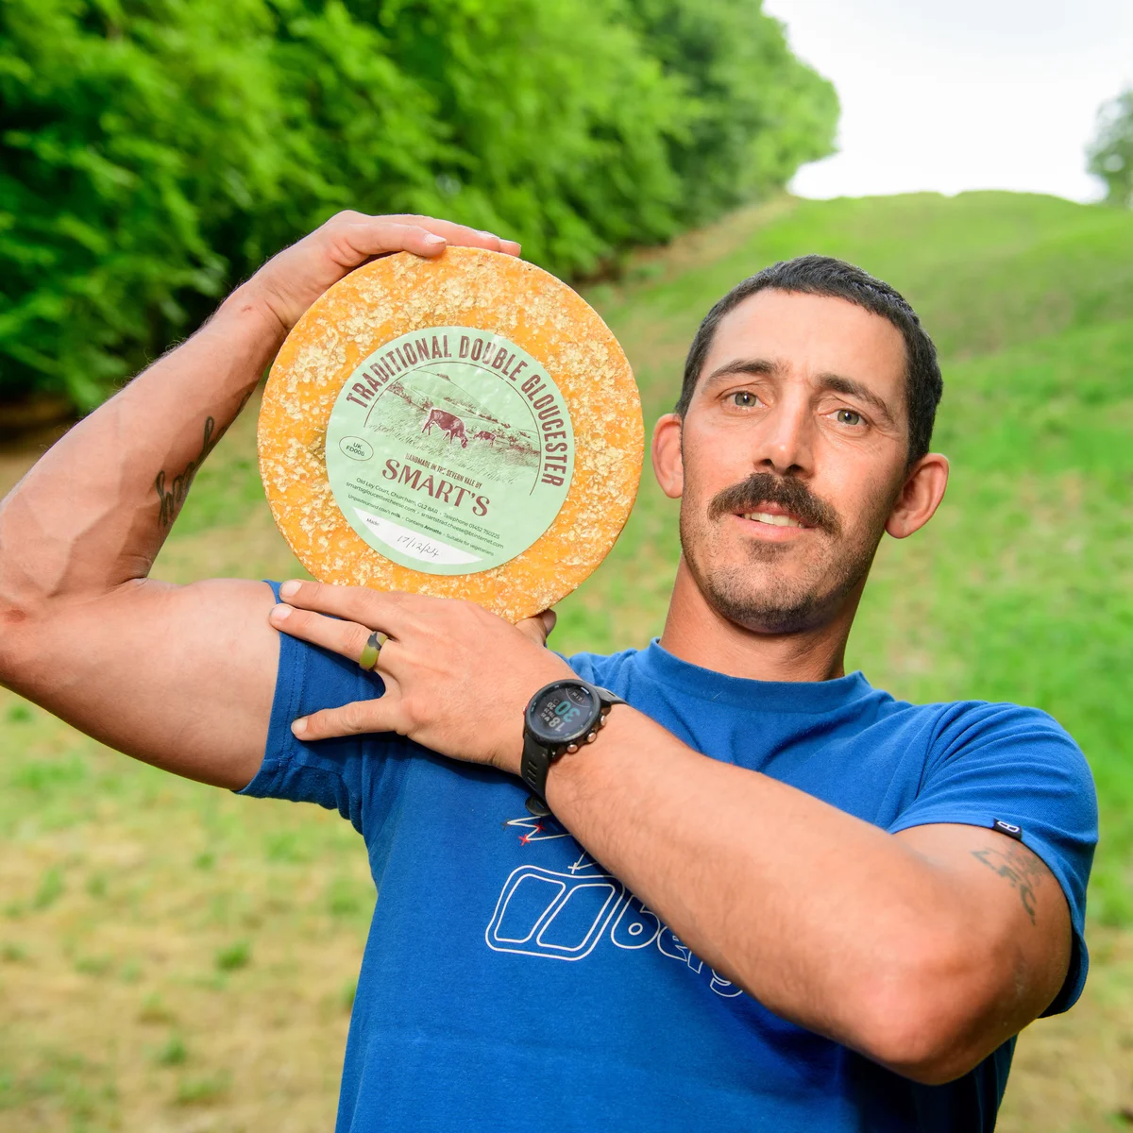
Page 1 contents
Recent Notable Winners (2022-2025)
2025: German Tom Kopke won the first men's race for the second year in a row. The women's race was won by London student Ava Sender Logan, and Australian Byron Smith won the final men's race.
2024: Winners included German Tom Kopke (Race 1), Australian Dylan Twiss (Race 2), and local Josh Shepherd (Race 3). The women's race was won by American Abby Lampe for the second time.
2023: The first men's race was won by Matt Crolla from Manchester. Delaney Irving from Canada won the women's race after being briefly knocked unconscious. Ryoya Minami from Japan also won a race.
2022: The event returned after a pandemic-enforced break, with champion Chris Anderson winning his 23rd race, after which he announced his retirement. Abby Lampe from the USA won the women's race.
Results in the past years
Dominant Champions (2005-2022)
The period has been dominated by a few key individuals who achieved multiple victories:
Chris Anderson (Brockworth, UK) holds the world record for the most wins, with a total of 23 cheeses between 2005 and 2022. He often won multiple races in a single year.
Flo Early (UK) was a prominent force in the women's event, securing four wins in total across 2008, 2016, 2018, and 2019.
Dionne Carter (Australia) tied the women's record of three wins in 2004, 2005, and 2006.
Jason Crowther was a three-time winner in the mid-2000s, winning the first men's race from 2005 to 2007.
Chris Anderson

Slide 5
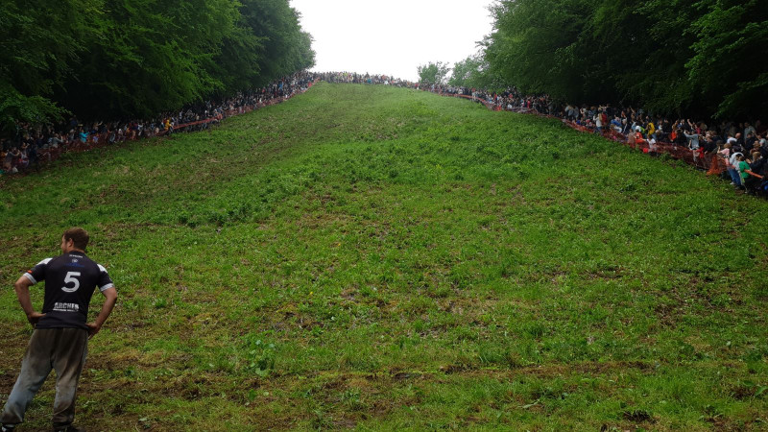
Page 2 contents
Cooper's Hill in Brockworth, Gloucestershire, England
Places to race
The main place for a cheese hill race is Cooper's Hill in Brockworth, Gloucestershire, England, famous for its steep gradient (1:2) and the annual, chaotic pursuit of a Double Gloucester cheese wheel, a tradition dating back centuries, drawing large crowds and participants willing to risk tumbles for the prize. While Cooper's Hill is the iconic spot, you'll find related cheese festivals, like the Big Cheese Festival in Caerphilly, but the actual rolling race is synonymous with this specific English hill.
Why Cooper's Hill?
Extreme Gradient: The hill is incredibly steep, making for a fast and dangerous race where participants often tumble down.
Tradition: It's a long-standing event, potentially centuries old, with pagan or grazing rights origins, making it a unique cultural experience.
The Prize: A wheel of Double Gloucester cheese is rolled, and the first person to cross the finish line at the bottom wins it.

Slide 6
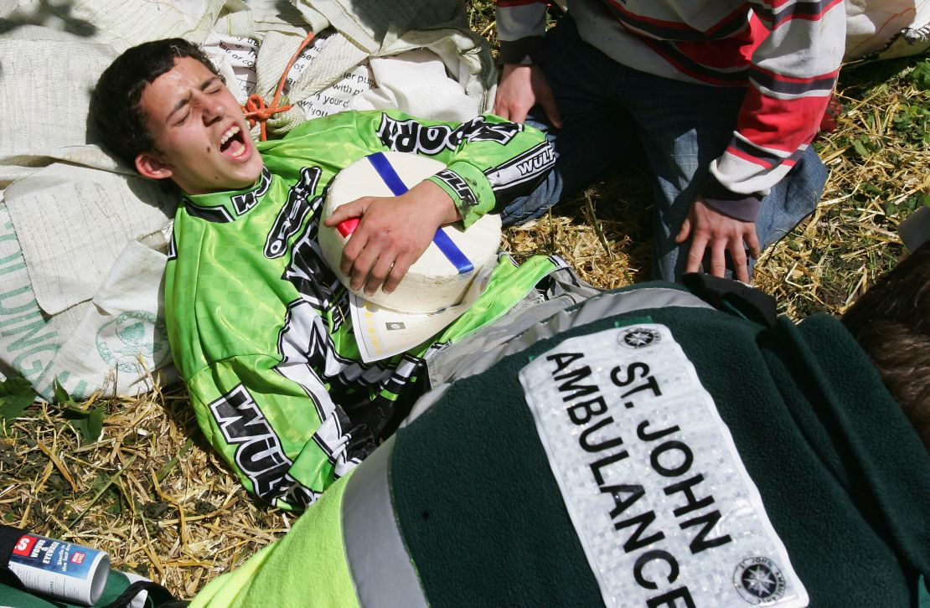
Page 3 contents
Health hazards
Common Health Hazards & Injuries
Participants frequently suffer from a range of injuries due to falls and collisions while tumbling down the 200-yard, 1-in-1 gradient hill.
Broken Bones: This is one of the most common types of injury, with participants frequently suffering from broken ankles, collarbones, wrists, and legs.
Concussion and Head Injuries: The chaotic, tumbling descent often results in head trauma and concussions; the 2023 women's champion was knocked unconscious just before the finish line.
Sprains and Dislocations: Ankle sprains and dislocated shoulders are also common occurrences.
Cuts, Bruises, and Grazes: Minor injuries like cuts, bruises, and muscle tears are almost guaranteed for anyone who tumbles down the hill.
Internal Injuries: More serious, though less frequent, internal injuries like bruised kidneys or a collapsed lung have been reported.
Spectator Injuries: Even spectators are at risk, with some being hit by the hard, 3kg Double Gloucester cheese wheels that can reach speeds of up to 70 mph.

Slide 7
Extra features…
Get video https://www.youtube.com/watch?v=lLLyIk7rTBA
Link nav bar

