Slide 1
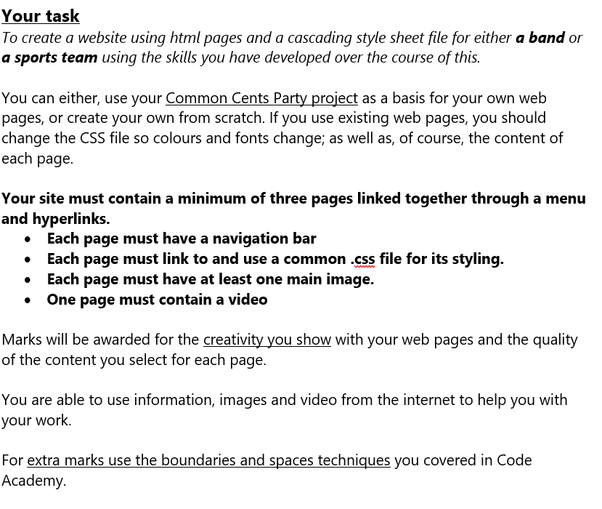
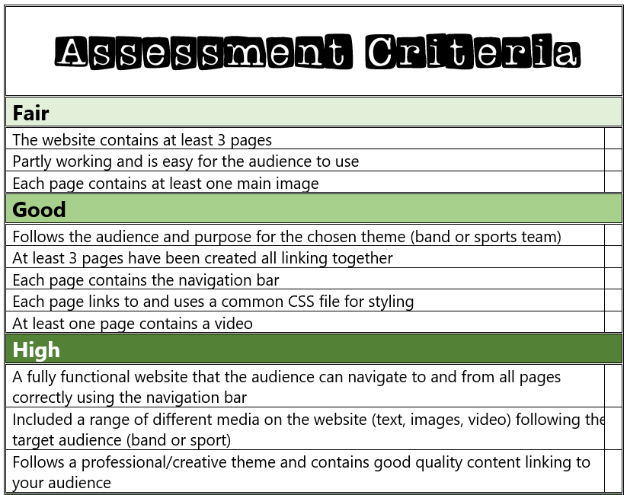
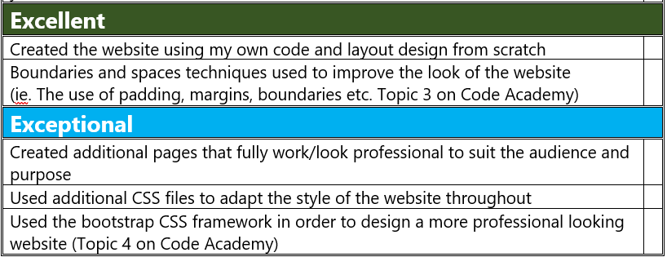

Slide 2
My Website Design Plan

Slide 3
Website moodboard – what is your website about?
My website is about Tottenham
The colour will be blue and vibrant

Slide 4
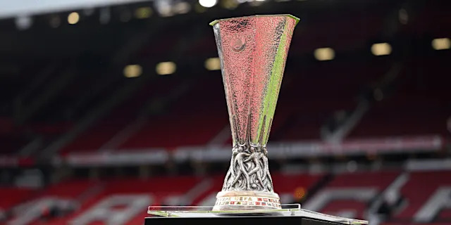
Page 1 contents
Tottenhams Trophy https://sports.yahoo.com/article/2025-europa-league-final-date-213000986.html
🏆 Major success — Europa League winners
Tottenham won the 2024/25 Europa League, beating Manchester United 1-0 in the final in Bilbao.
The winning goal was scored by Brennan Johnson in the 42nd minute — a close-range finish after a cross from Pape Sarr. That ended a 17-year wait for a major trophy for Spurs (last won in 2008) and their first European title since 1984. 📈 Route to the trophy
Spurs navigated the “league phase” (the Europa League’s new format) finishing 4th — enough to go straight to the Round of 16. Knockout rounds: overcame AZ Alkmaar on aggregate (3–2), beat Eintracht Frankfurt 2–1 on aggregate in the quarter-finals, then comfortably dispatched FK Bodø/Glimt 5–1 on aggregate in the semi-final.
🧱 Defence & leadership — key to the final push
Defender Cristian Romero — back in the squad for the knockout stage — played every game from quarter-finals onward and was named “Europa League Player of the Season.” In the final, Spurs defended resolutely — a goal-line clearance from Micky van de Ven and a late save from Guglielmo Vicario helped preserve the 1-0 lead.
⚠️ Domestic struggles contrasted with European triumph
Despite European glory, Spurs had a dismal domestic season — finishing 17th in the league with just 38 points, their lowest top-flight finish in decadesThat made them one of the lowest-placed league finishers to ever win a major European trophy. ✔️ Impact & broader significance
The win restores some pride and silverware to the club after years of near-misses and underperformance.
It also secured qualification for the next season’s UEFA Champions League — a major boost despite domestic woes. If you like — I can also summarise top performers, stats and key moments from the full Europa League run for Spurs this season, showing a match-by-match breakdown.

Slide 5
Page 2 contents
Tottenhams players

Slide 6
Page 3 contents

Slide 7
Extra features…

