Slide 1
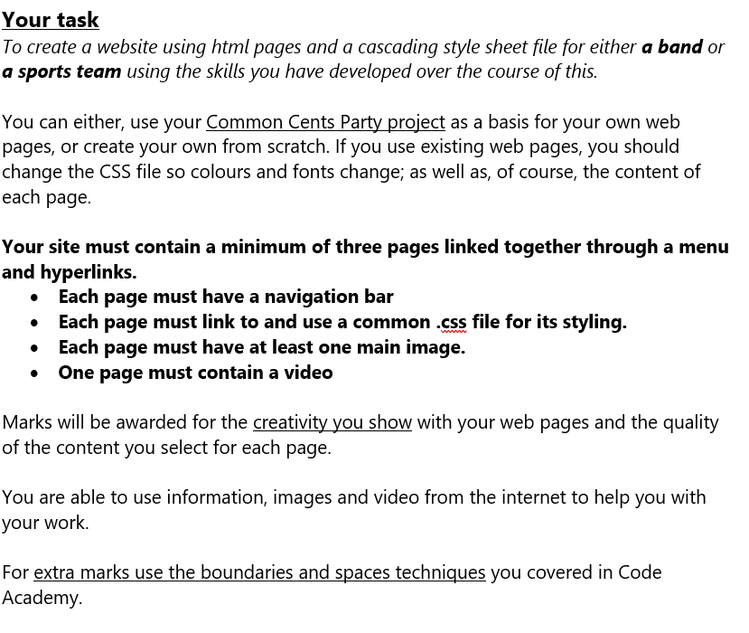
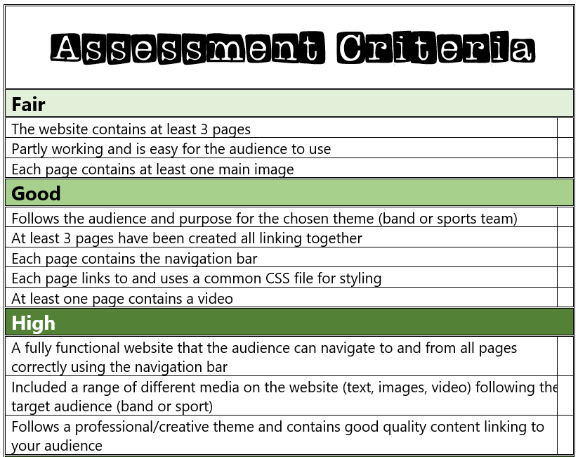
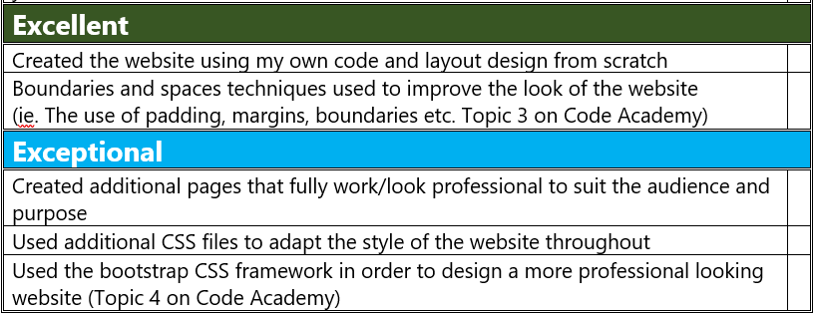

Slide 2
Tennis
By Ro

Slide 3
Website mood board – what is your website about?
My website is about:
.Tennis
.Its most famous and best players
.The most famous grounds and competitions

Slide 4
Homepage-Why I think Tennis is a great sport
Tennis is a uniquely rewarding sport because it challenges the body and mind at the same time. It demands speed, endurance, coordination, and precision, making every match a full-body workout that improves strength and cardiovascular health. Beyond the physical benefits, tennis also sharpens mental skills such as strategy, focus, and emotional resilience. Each point requires quick thinking, adaptability, and the ability to stay calm under pressure.
One reason tennis is so inspiring is the greatness of the athletes who have shaped the sport. Legends like Roger Federer, Serena Williams, Rafael Nadal, and Novak Djokovic have shown what dedication and passion can achieve. Federer’s elegance, Serena’s power and determination, Nadal’s relentless intensity, and Djokovic’s mental toughness provide models for players of all ages. Watching them helps beginners and seasoned athletes alike understand the beauty of shot-making, footwork, and competitive spirit.
Tennis is also accessible—you can play casually with friends or competitively in leagues, and it’s enjoyable at any age. Whether hitting on a local court or competing in a tournament, the sport fosters discipline, sportsmanship, and a lifelong love of staying active. These qualities make tennis not just a game, but a source of personal growth and joy. (Very Detailed)

Slide 5
The importance of tennis
A brief summary on how great and important tennis is and why its such a blast to play.
Includes my honest opinion on this sport and why I personally play it.
It has a purple theme for Wimbledon.
Very informative page.

Slide 6
Page 3-The most famous tennis grounds
Gives a detailed paragraph on how we can protect our Earth which includes pollution, Littering, sea life, and how all of this effects or world for the future generations.
The whole theme of this page is the sea containing blue and white colours around the page.

Slide 7
Extra features…
A video containing Rafael Nadal winning a point-https://www.youtube.com/watch?v=cDv6uCyq8OE
An image of Roger Federer lifting up The Wimbledon trophy- https://www.google.com/search?sca_esv=2d4270db18fb807d&rlz=1C1GCEA_enGB1190GB1190&udm=2&fbs=AIIjpHxU7SXXniUZfeShr2fp4giZrjP_Cx0LI1Ytb_FGcOviEiTm5uW1q0uNfK7KsnoL8hUyUYUJLZ_b-p0lT09DIkR7bwzZ58goNnPFwCobO9Lr1FJy27_ddIL61O5aDZqsFHeKdbTBa3SWM9BbE6jpBPGlXzcFCH1KrIQ9yHBjyi-ZLJUInBy54epU8g3fHyjXolCFfseHfRcNjgYhOadYKw2rr0vq-A&q=roger+federer+winning+at+wimbledon&sa=X&ved=2ahUKEwiMyuHI37-RAxXuR0EAHWuyC5oQtKgLegQIExAB&biw=1920&bih=953&dpr=1#vhid=x_r1W-7sVb-I8M&vssid=mosaic

